Slide 1
Good food
Bad food
cards
Ph (08) 89481768 P.O.Box 1464, NIGHTCLIFF, NT, 0814 www.amrric.org
Notes:
This activity aims to teach students what to feed and what not to feed dogs.

Slide 2
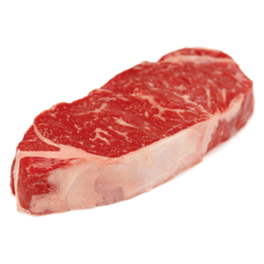
Notes:
Meat is good to feed dogs. It contains protein and fat for dogs to put on weight. It also helps mend sores and fight sickness and disease, such as mites. Iron in meat makes blood stronger.

Slide 3
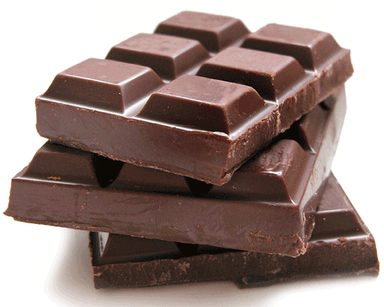
Notes:
Chocolate is bad for dogs as it can make them sick.

Slide 4
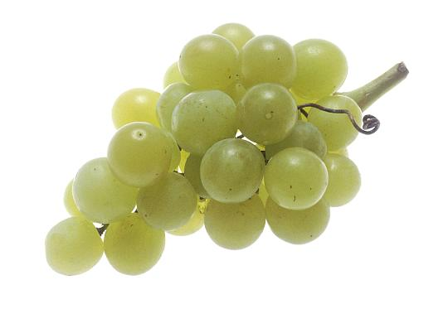
Notes:
Grapes can make dogs sick, so grapes are bad for dogs.

Slide 5
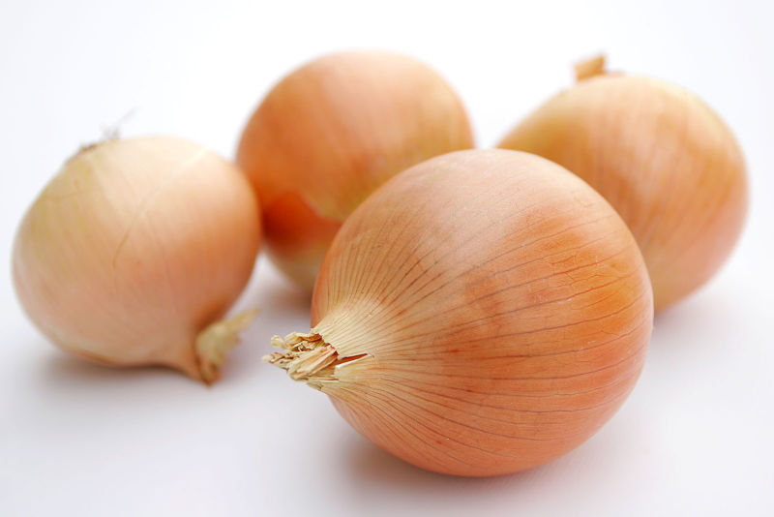
Notes:
Onions are bad for dogs and can make them sick.

Slide 6
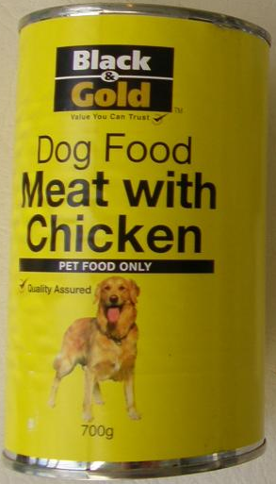
Notes:
Tinned and dry foods have the right amount of protein, vitamins, minerals and energy to keep dogs healthy. Tinned and dry foods are good for dogs.

Slide 7
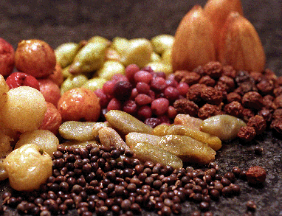
Notes:
Bush tucker is good for dogs to eat. They have vitamins and carbohydrates for energy and to fight sickness.

Slide 8
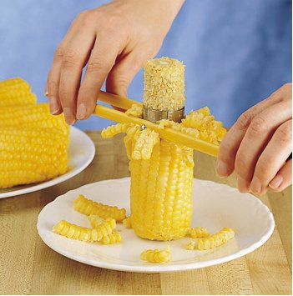
Notes:
Corn cobs can be bad for dogs because they can get stuck in the dogs throat and hurt the dog.

Slide 9
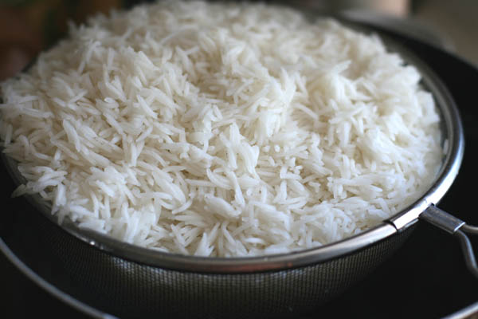
Notes:
Rice is good for dogs because it contains carbohydrates for energy. It makes them full and helps put on weight.

Slide 10
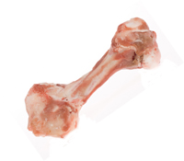
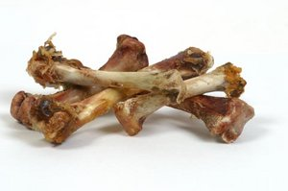
Notes:
Bones contain calcium which is important in making bones and teeth grow well. However, chicken bones are brittle and can break into sharp shards that can hurt the inside of the dogs gut.

Slide 11
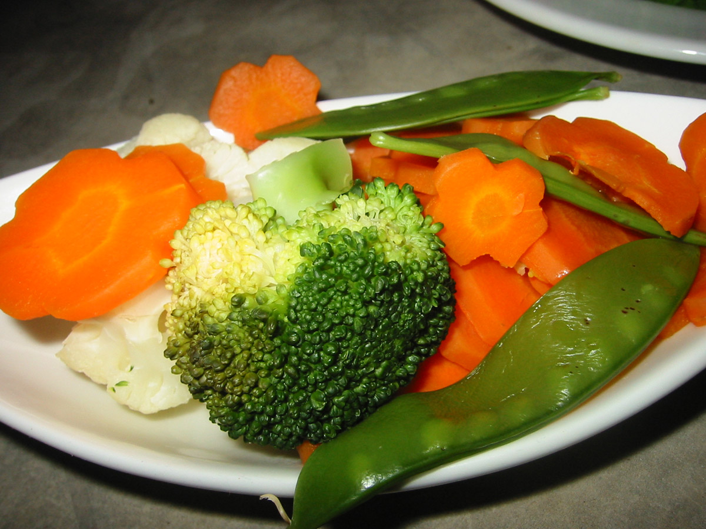
Notes:
Vegetables are important for dogs to eat. Vegetables have vitamins and carbohydrates for energy and to fight sickness.

Slide 12
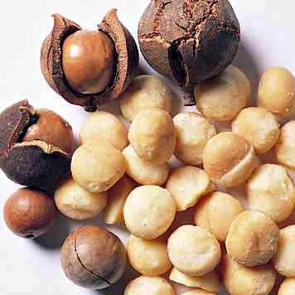
Notes:
Macadamia nuts can make dogs sick so do not feed dogs macadamia nuts.

Slide 13
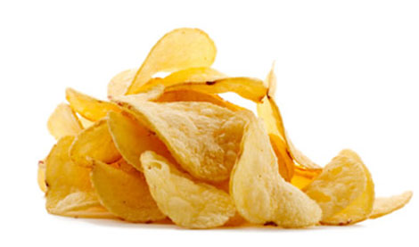
Notes:
Too much junk food, like chips, can be bad for dogs. Dogs can eat junk food sometimes, but not all the time.

Slide 14
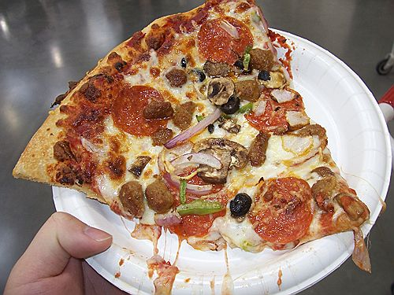
Notes:
Too much junk food, like pizza, can be bad for dogs. Dogs can eat junk food sometimes, but not all the time.

Slide 15
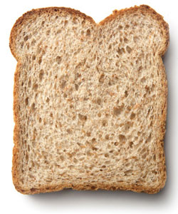
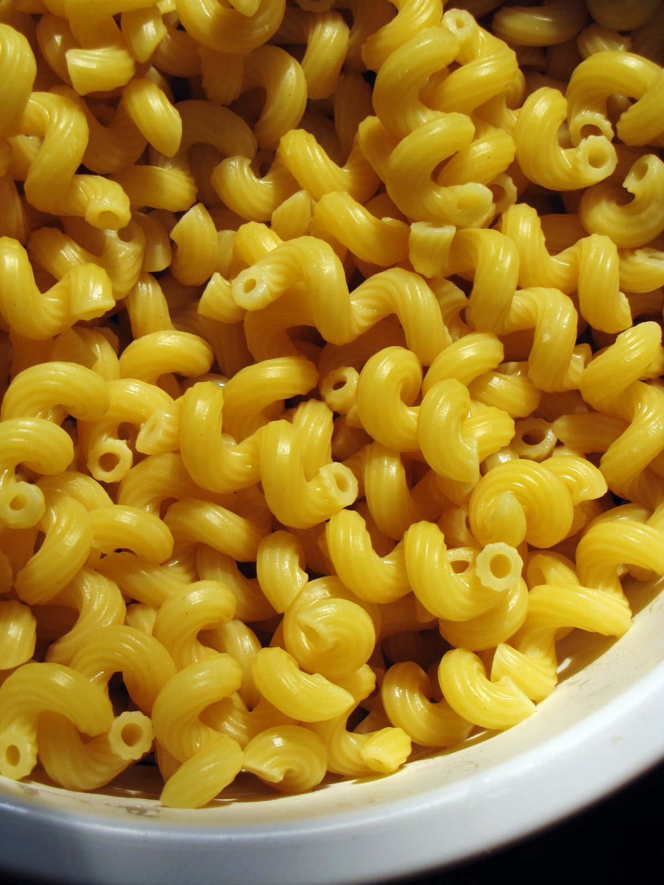
Notes:
Bread and Pasta are good for dogs. They contain carbohydrates for energy. They make dogs full and helps put on weight.

Slide 16
Good Food:
Meat
Dog Food
Bush Tucker
Corn Kernels
Rice
Raw bones
Vegetables
Bread
Pasta
Bad Food:
Chocolate
Grapes
Onion
Corn Cob
Cooked bones
Macadamia nuts
Sometimes ok:
Chips
Pizza
Junk food

