Slide 1
Felt Dog
A resource to visually teach people how disease and medicine affects the dog

Slide 2
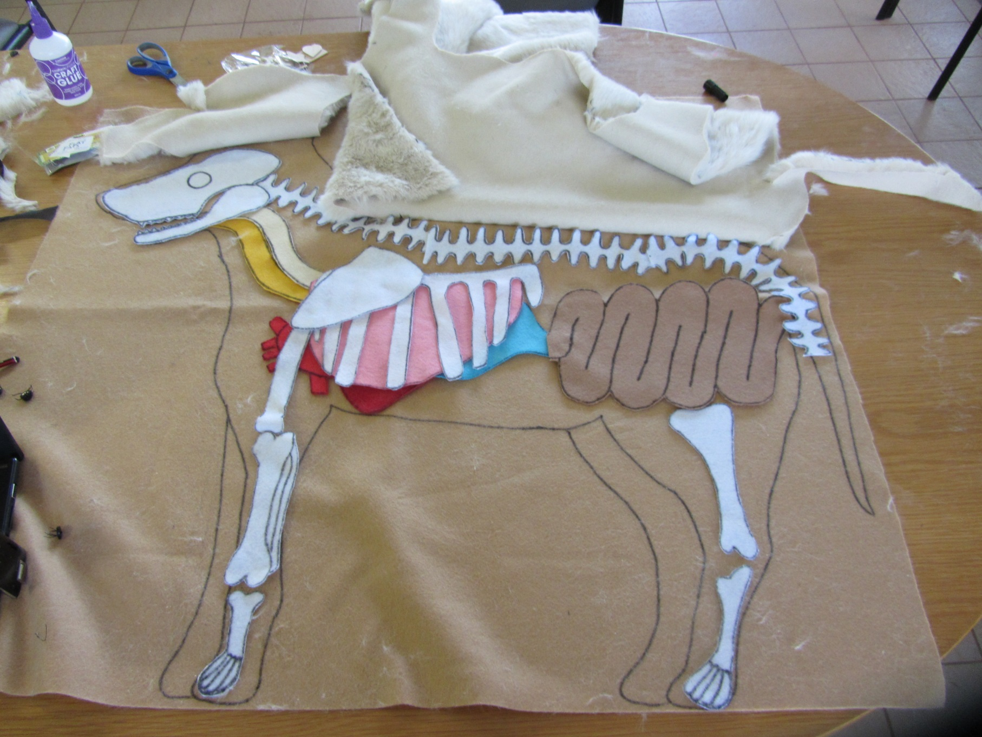
Notes:
This is an example of how felt dog can look once complete. The organs are detachable so specific organs can be focused on when explaining how different diseases and medicines affect the inside of the dog. Organs can be labelled in English and also the local language.

Slide 3
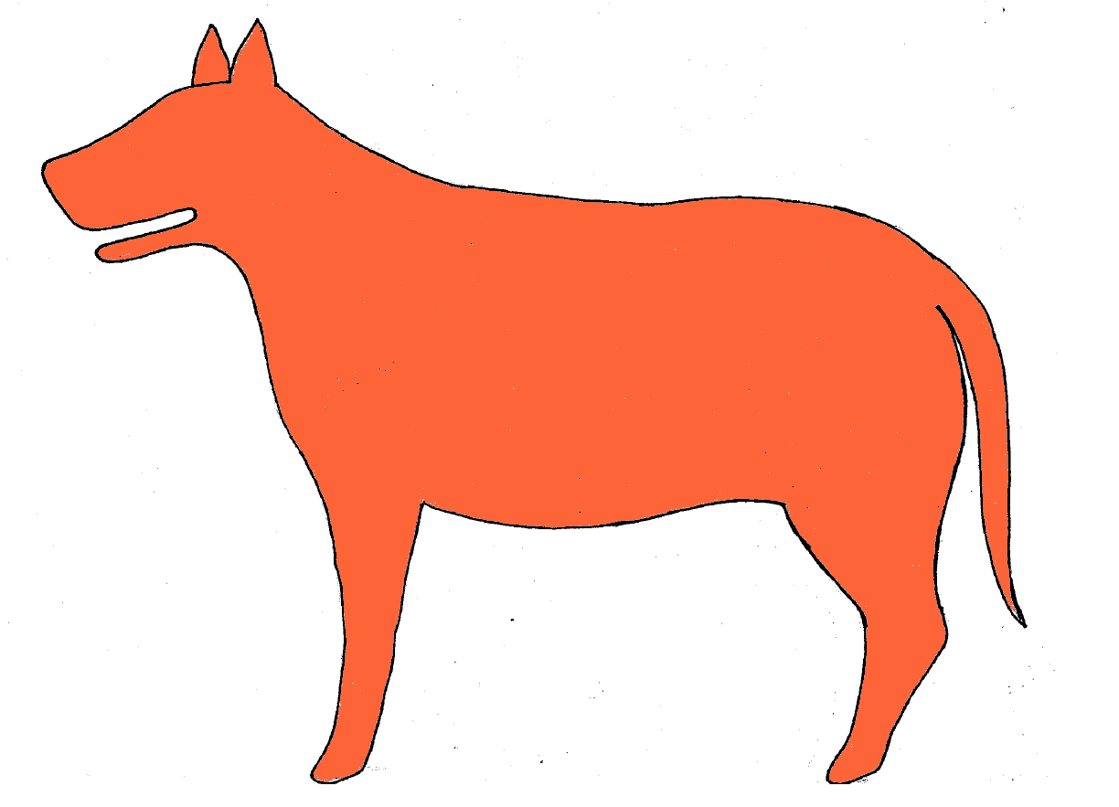
Notes:
Enlarge this image to A3 or larger and trace onto a large piece of felt. This will be the base and outline of felt dog.

Slide 4
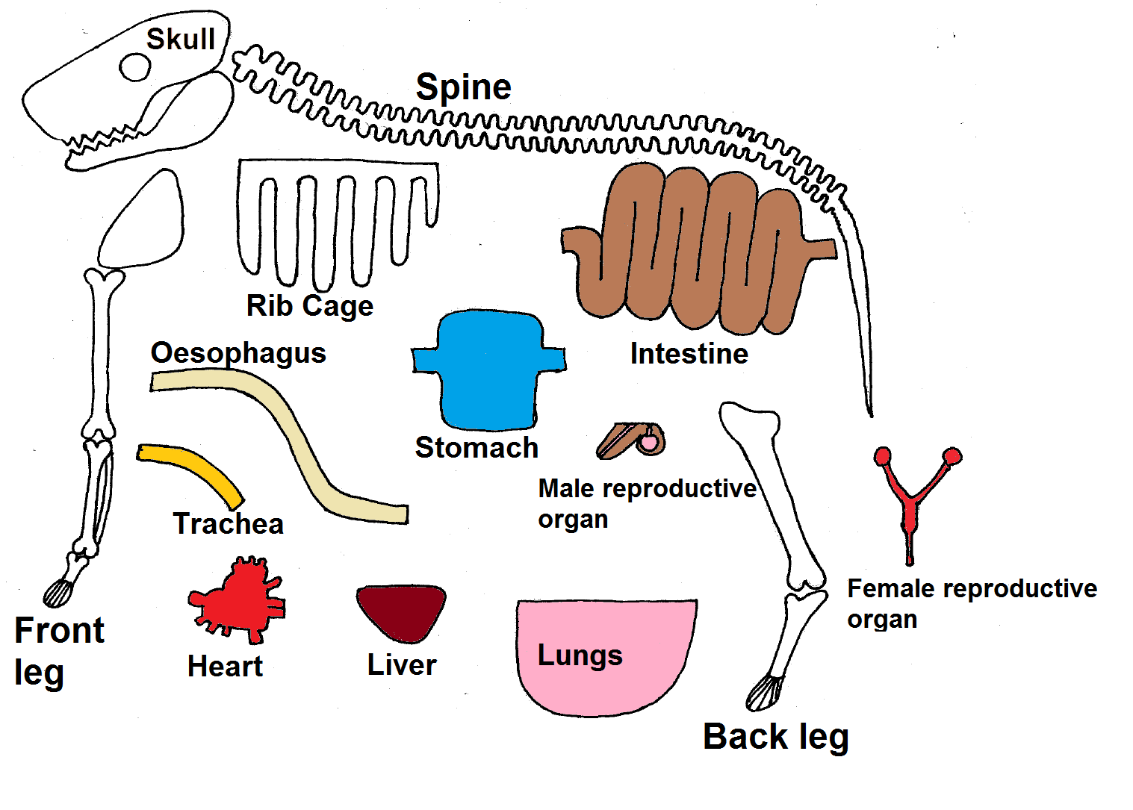
Notes:
Enlarge this image to the same size as the felt dog outline. Trace the organs and bones onto different coloured pieces of felt. Cut the organs and bones and place in the appropriate areas (google image for some ideas). Once complete, create diseases (such as ticks and worms) and medicines (such as worming tablets) and use these to show how disease affects the dogs body (for example, which organs they target) and how medicines remove the illness or help relieve symptoms.

