Slide 1
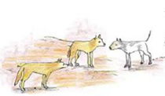

Dogs and Country

Slide 2
The health of the place we live in
has a big impact on our health.
Dogs can help us live well on country
but they can also dirty water, affect wildlife and
spread disease around where we live.
Wildlife
Feral animals
Dog-dingo hybrids
Rubbish
Sewerage
Yards

Slide 3
Wildlife
Dogs can help people hunt on country, and help keep them safe from snakes and other wild dogs
But dogs can also chase, hurt, and eat a lot of wildlife around communities.

Slide 4
Feral animals
Feral animals degrade country and compete with wildlife
People-created resources like water troughs support feral animals more than wildlife, who are more drought tolerant.
Stopping dripping taps and fencing off rubbish tips helps keep ferals down as well as making communities healthier for people and dogs
Dingoes keep feral cats and foxes down

Slide 5
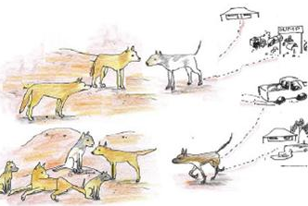
Dingoes
Dogs cross-breeding with dingoes threatens the survival of the dingo.
Dog-dingo hybrids can behave differently to dingoes, harassing stock more and breeding up more quickly.
Undesexed dogs in remote communities
are a source of strays right in
dingo heartlands.

Slide 6
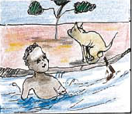
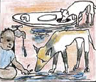

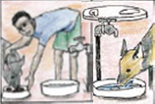
Water
Guna is filled with gut germs that make people sick
If our water sources get gut germs like Giardia in them, both people and dogs can get sick and spread disease.
Germs live longer in wet places, so fixing dripping taps and keeping yards dry keeps our homes healthy
Make sure there is always clean water for dogs to drink.

Slide 7
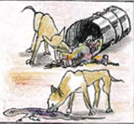
Rubbish
Rubbish is a great home for germs
Keep rubbish in the bin away from dogs and flies that will spread its germs.
Kimbes (nappies) are important to keep away from dogs, because it’s a direct source of human gut germs into dog guts, from where it can spread through dogs poos around the yard.
Fence off rubbish tips to stop dog and kids getting in.

Slide 8
Sewerage
Fix leaky sewerage pipes and tanks, and keeping kids and dogs out of sewerage ponds.
Dog poos are also sewerage, so keeping yards clear of dog poos is important too.

Slide 9
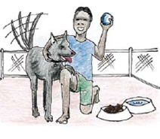
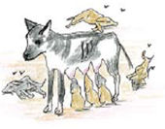
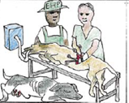
Desexing dogs
Puppies can’t fight off gut diseases very well. Germs multiply a lot inside the pups. Having a lot of pups multiplies the problem!
Desexed dogs also don’t contribute to overpopulation, are easier to keep healthy, and don’t threaten the dingo through crossbreeding.

Slide 10
Keeping where we live healthy
helps keep everyone and everything
happy, strong and healthy:
Land, water, wildlife, dogs and people

