Slide 1
What are we going to talk about today?

Slide 2
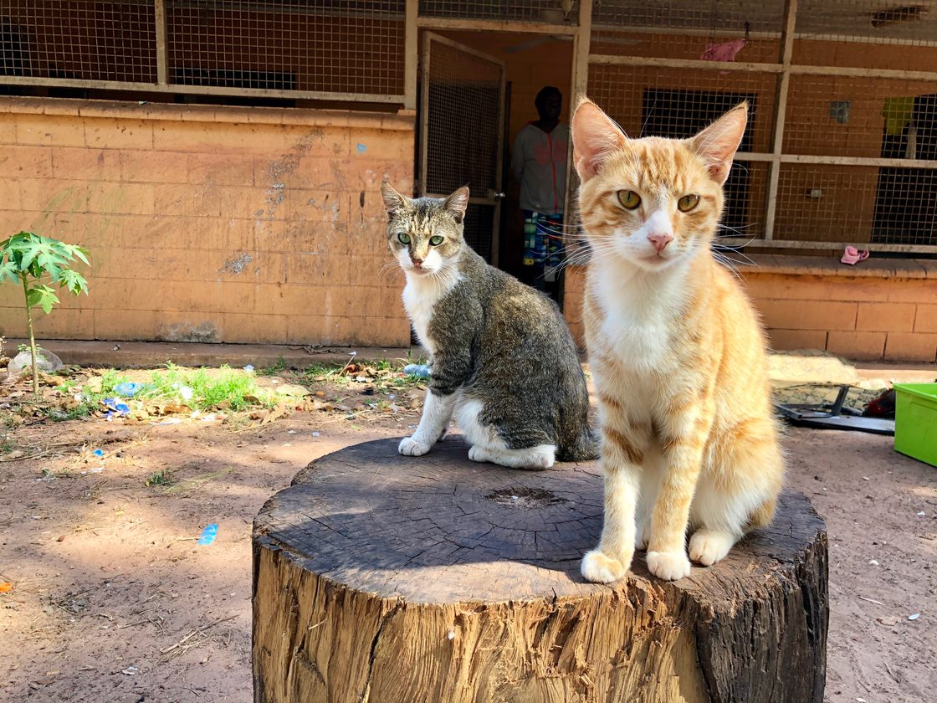

Slide 3
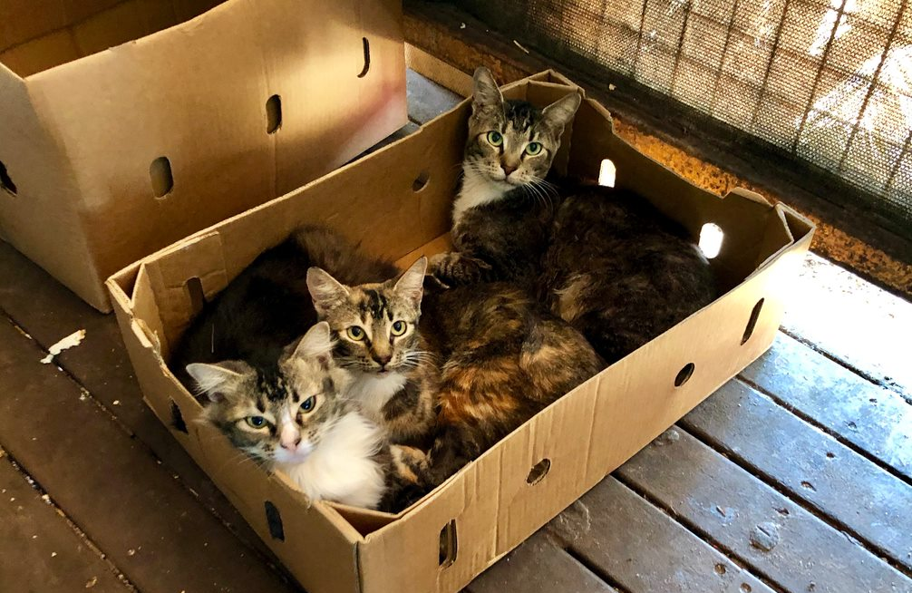
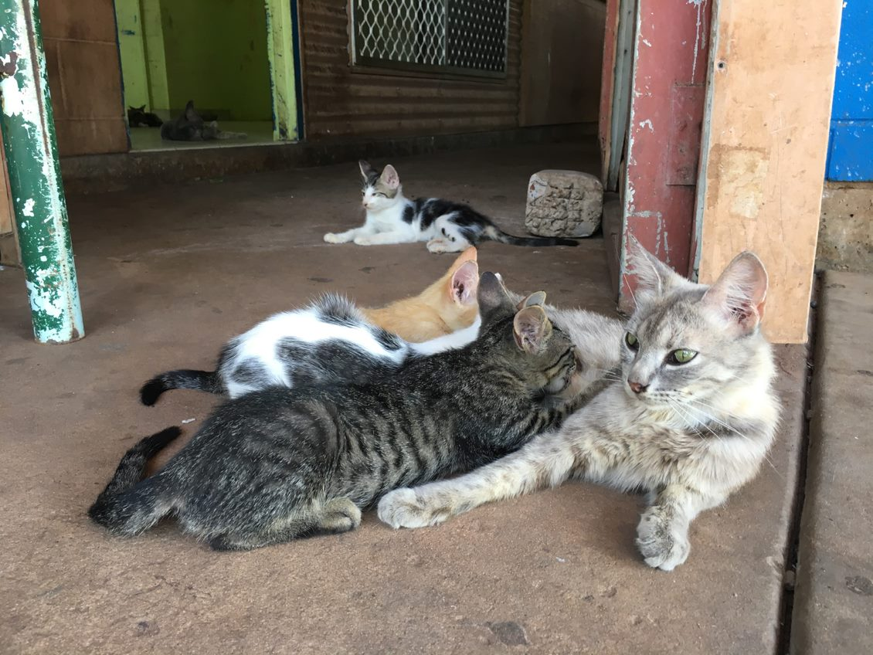
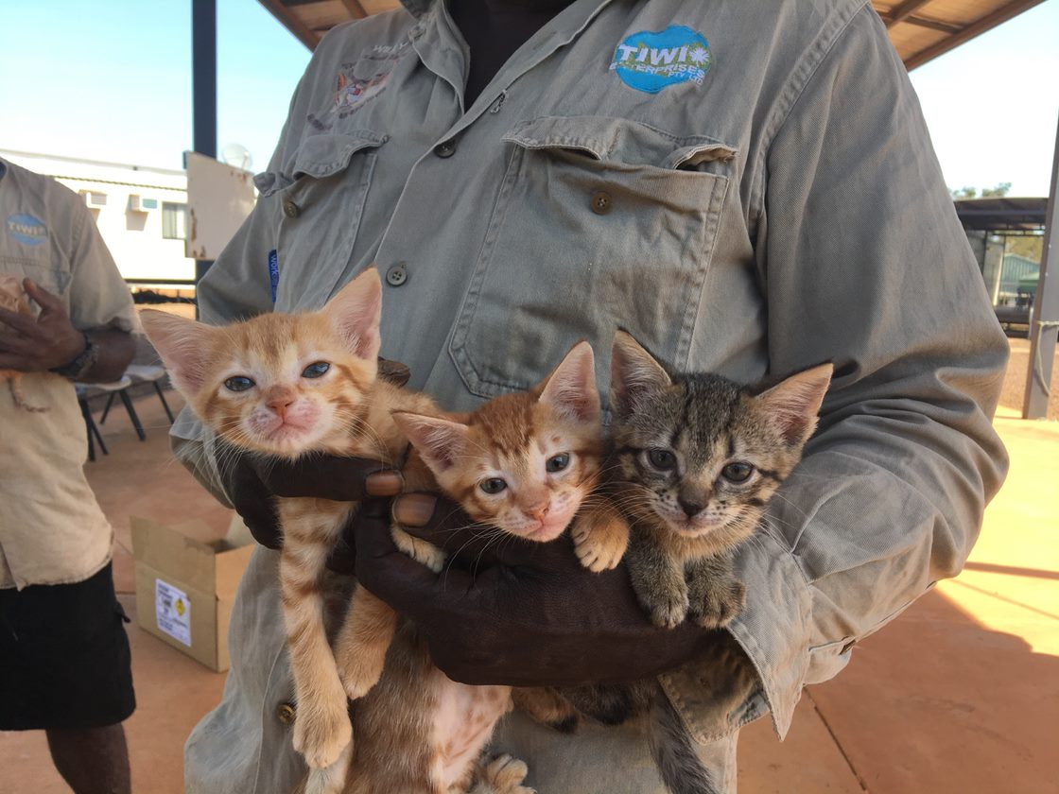
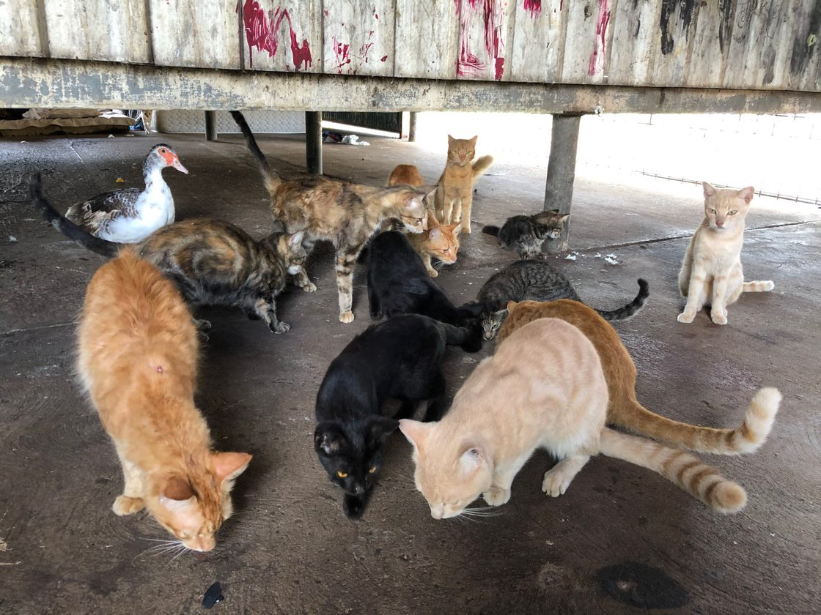

Slide 4
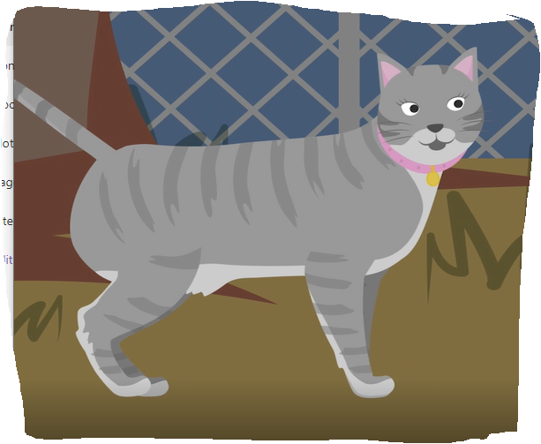
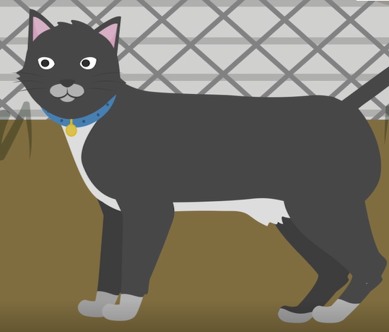
?
+
=

Slide 5
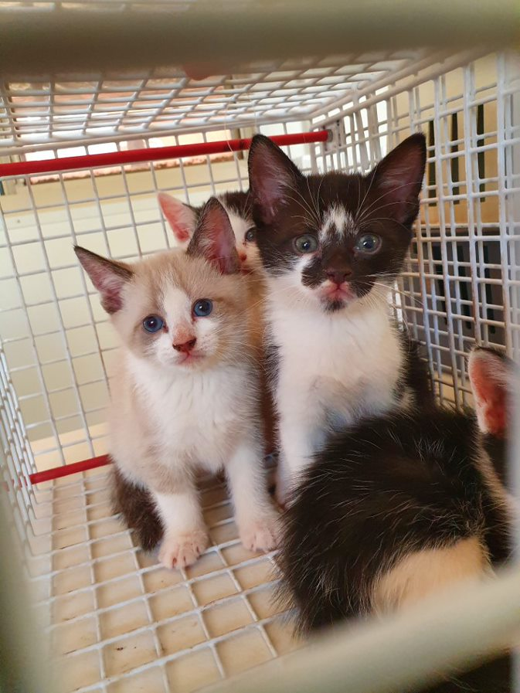
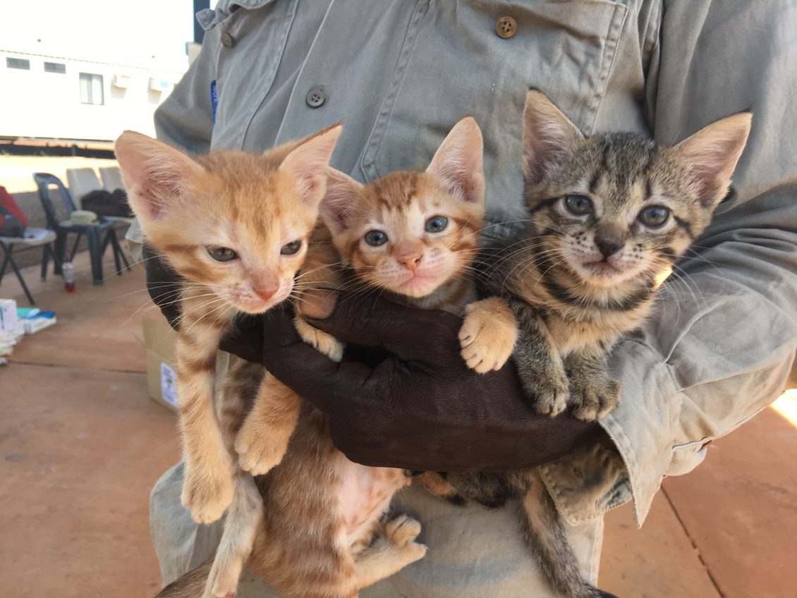

Slide 6
?
+
=

Slide 7
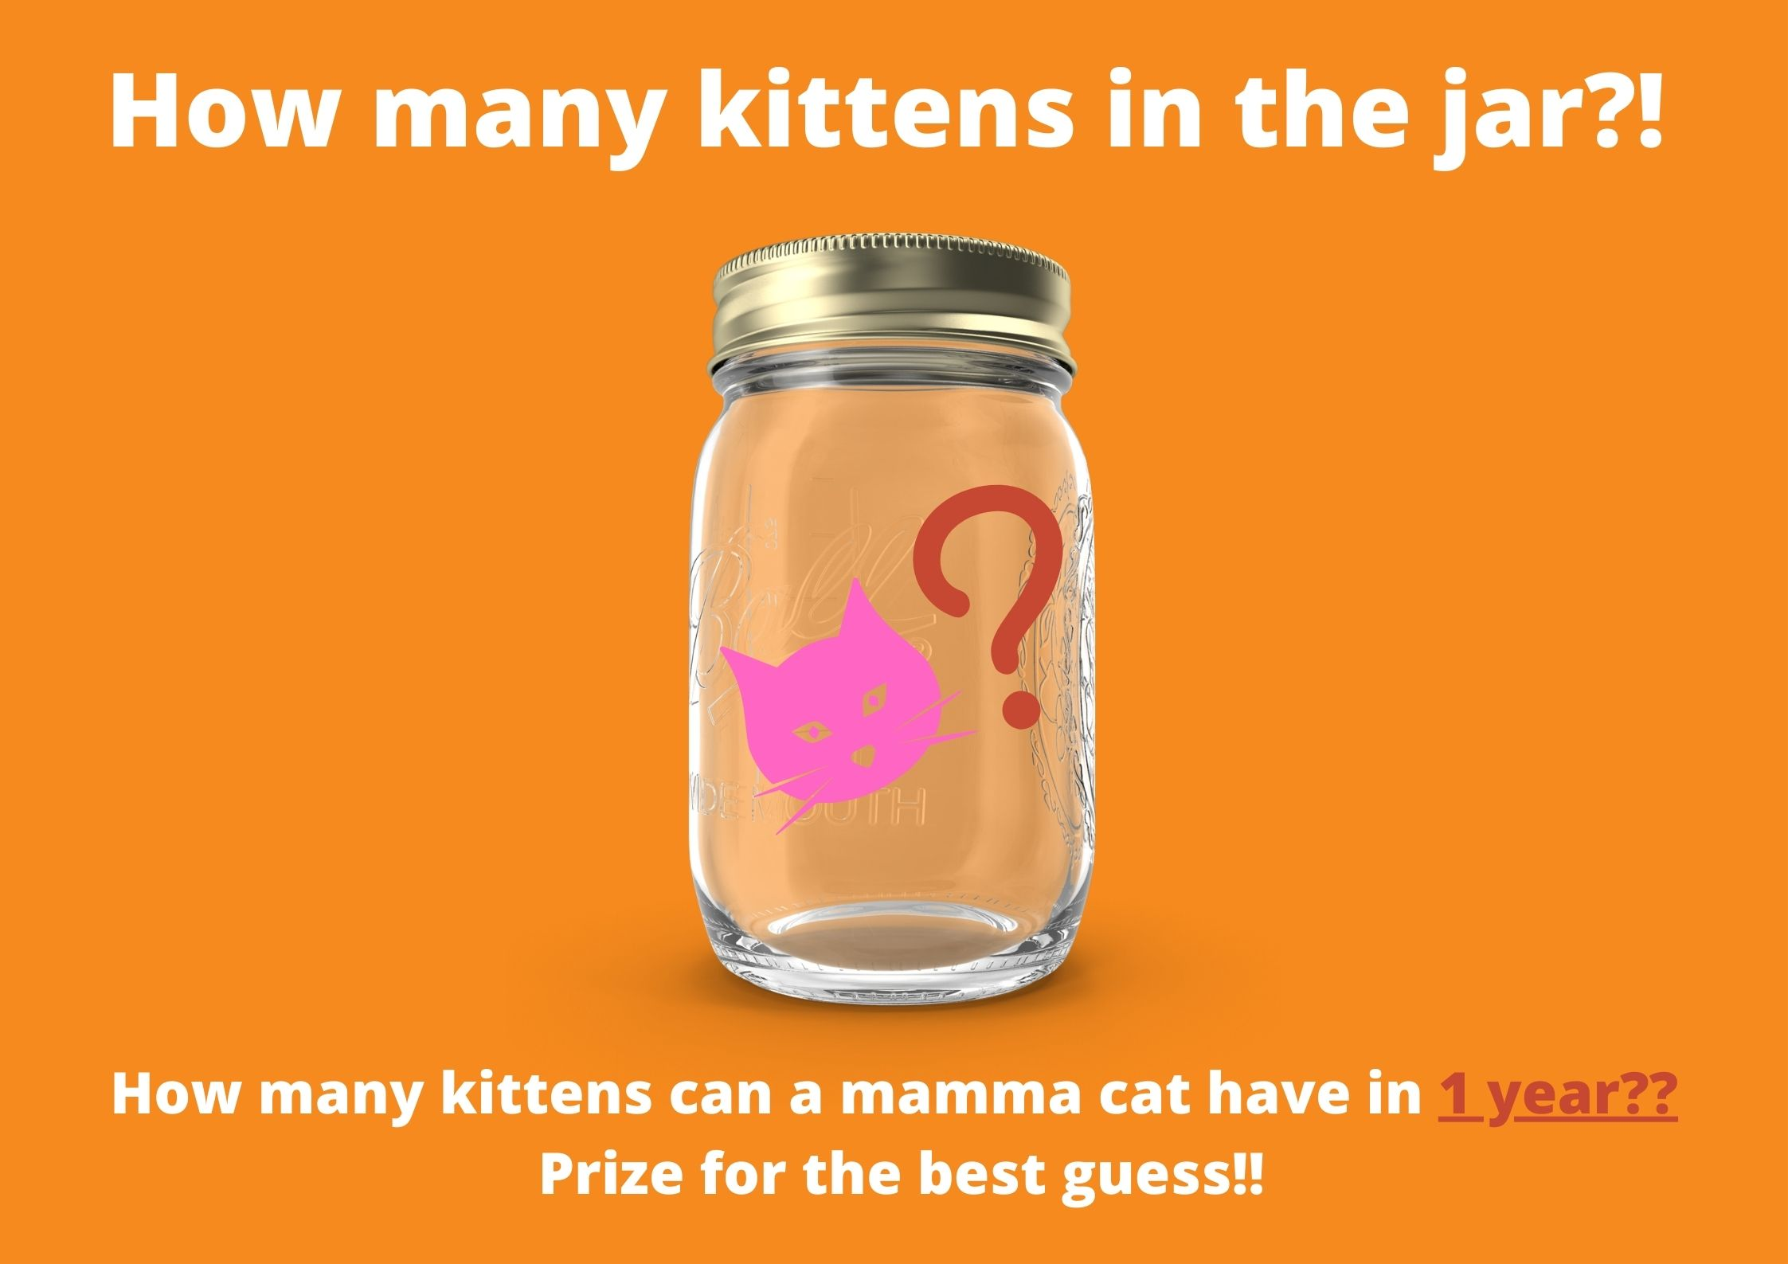

Slide 8
?
=
How many kittens in 1 year?

Slide 9
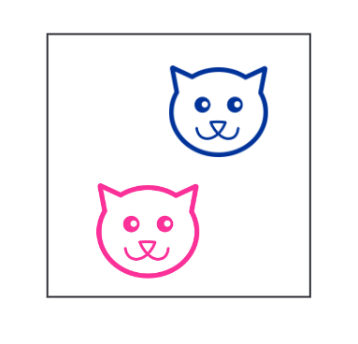
A
(2 cats)

Slide 10
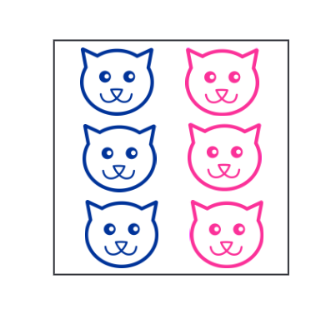
B
(24 cats)

Slide 11
C
(6 cats)

Slide 12
A
(2 cats)
B
(24 cats)
C
(6 cats)

Slide 13
Play cat breeding animation video here

Slide 14
Cat Breeding Mat Game
– (Link to lesson/downloadable resource here)

Slide 15
?
+
=
How many kittens in 1 year?

Slide 16
A
(2 cats)
B
(24 cats)
C
(6 cats)

Slide 17
B
(24 cats)

Slide 18

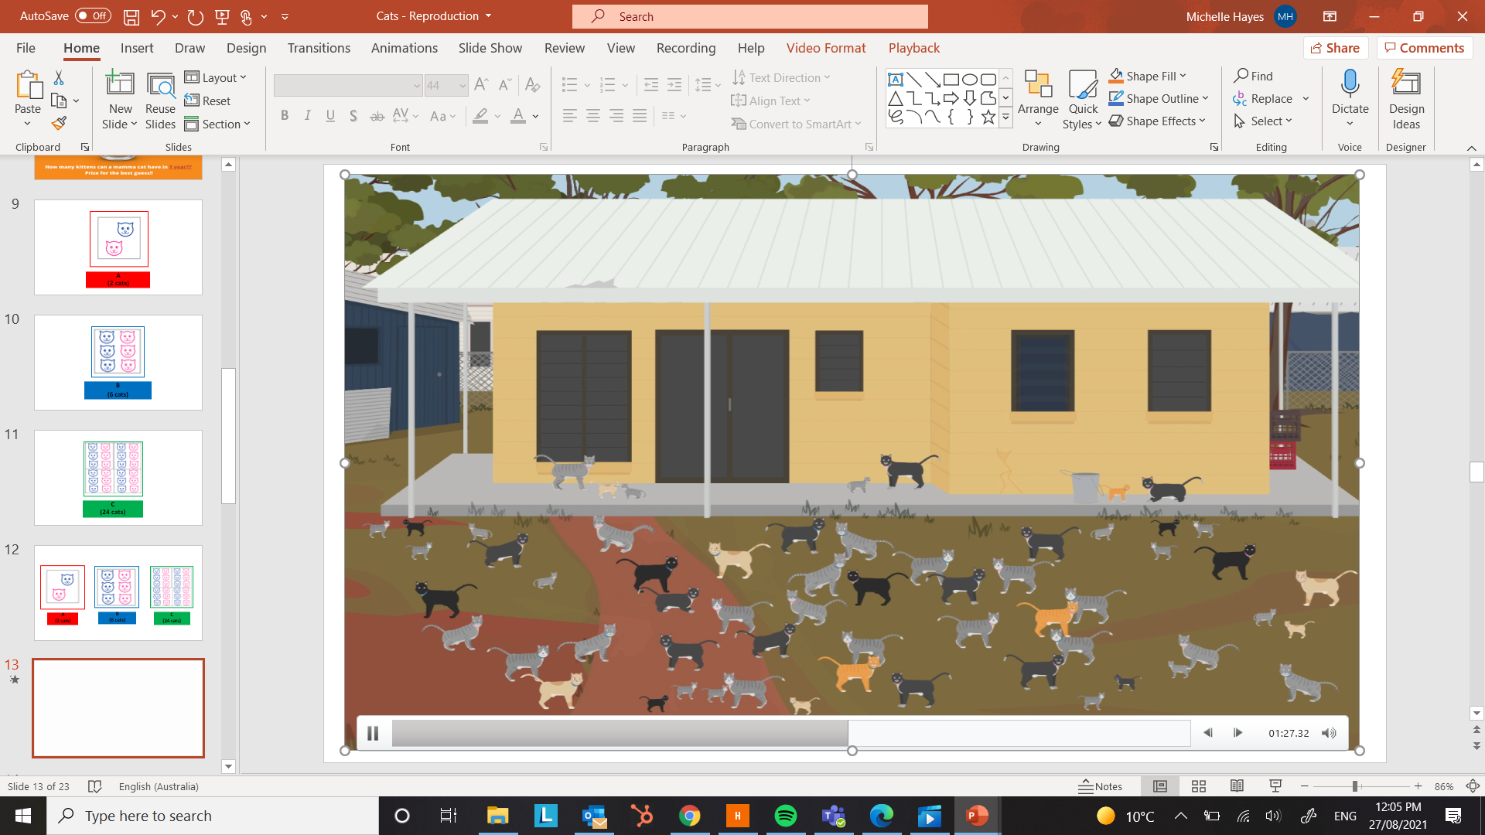
How do we stop our cats from having too many kittens?
?

Slide 19
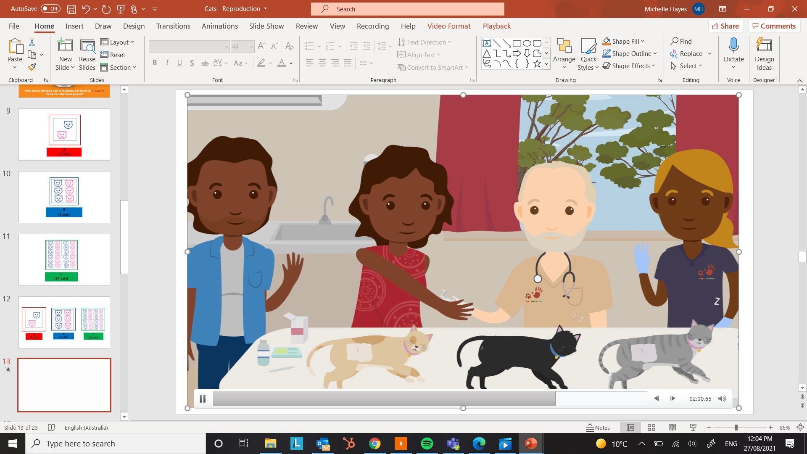

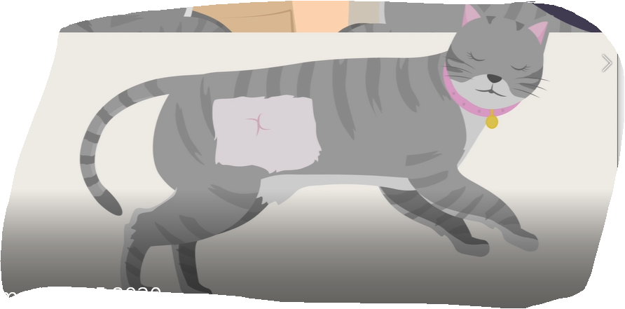
Operation - Desexing

Slide 20
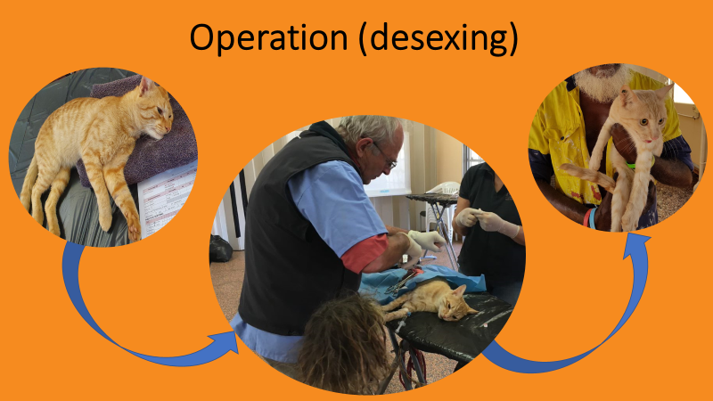

Slide 21


Operation = No more kittens
=

Slide 22

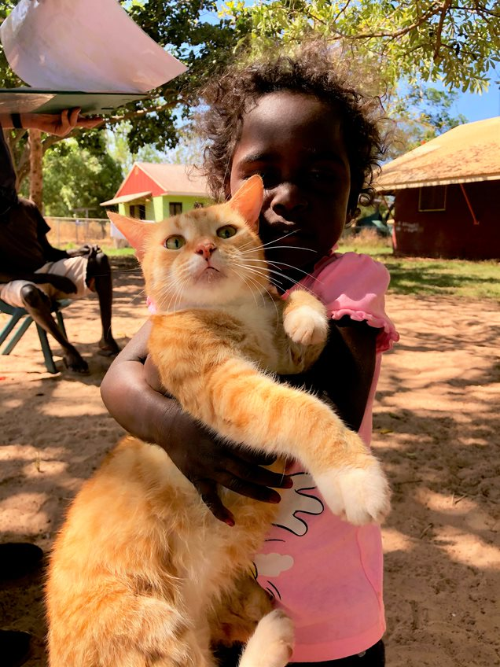

Operation = Happy Cats + Happy People

Slide 24
Colouring (link to colouring sheets for printing here)

