Slide 1
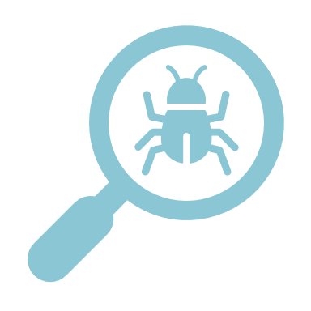
One Health in Remote Communities

Slide 2
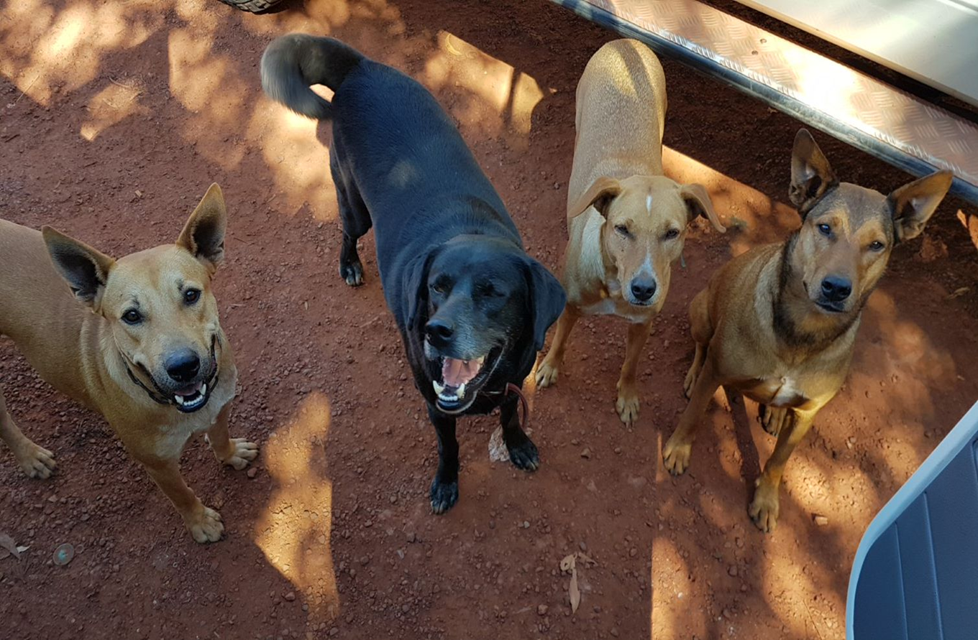
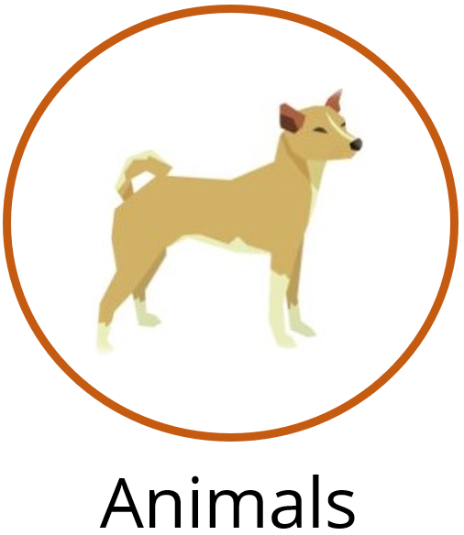

Slide 3
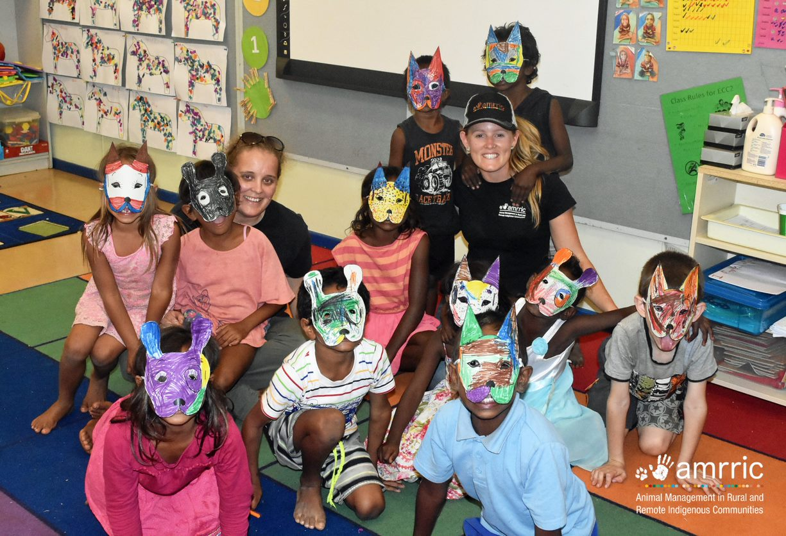

Slide 4
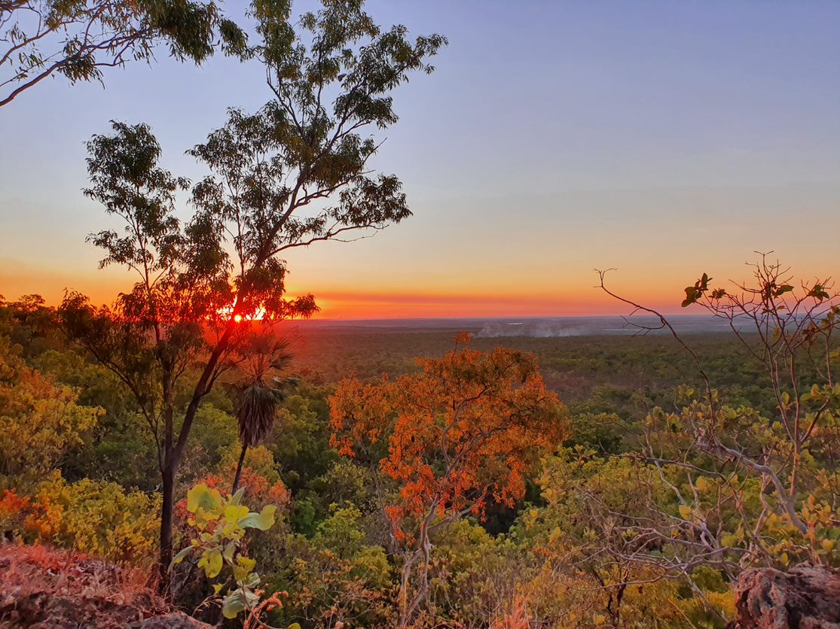

Slide 5
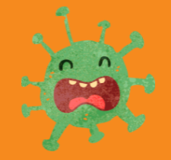
Disease and Germs

Slide 6
How does disease and germs affect animals, people, and country?
+
= ?

Slide 7
= Parvovirus

Slide 8
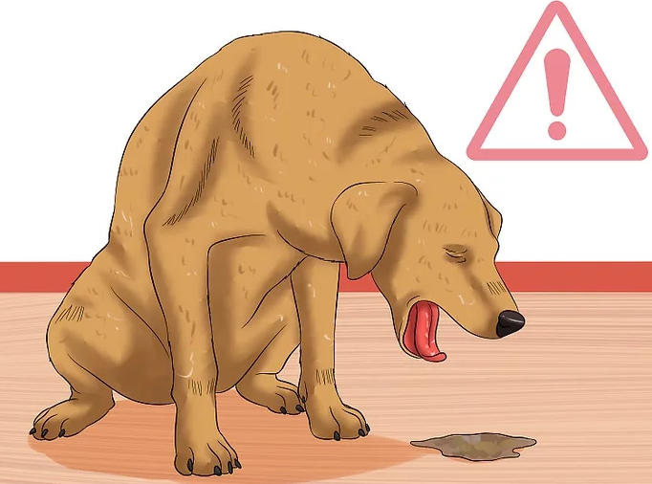
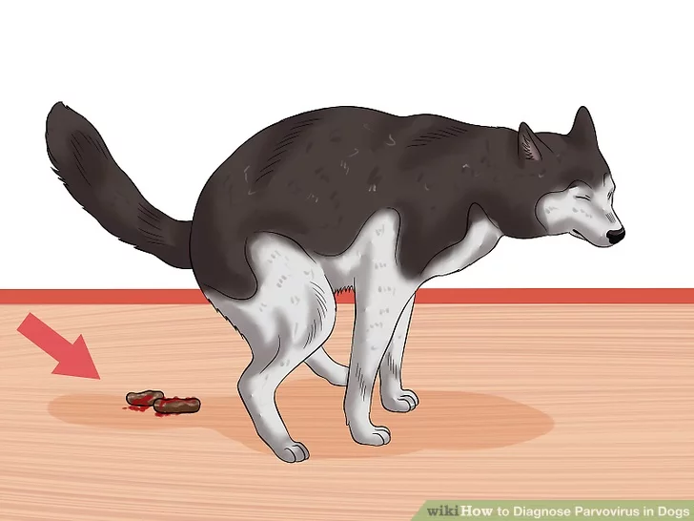
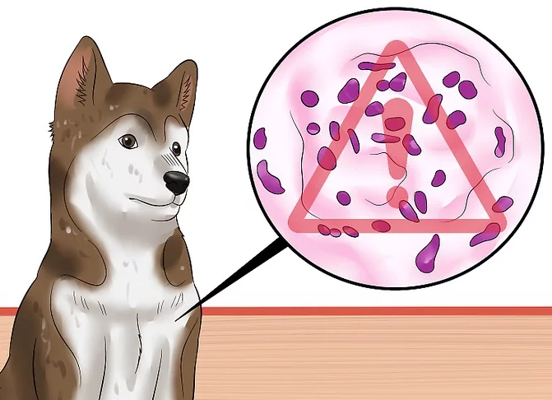
Parvovirus

Slide 9
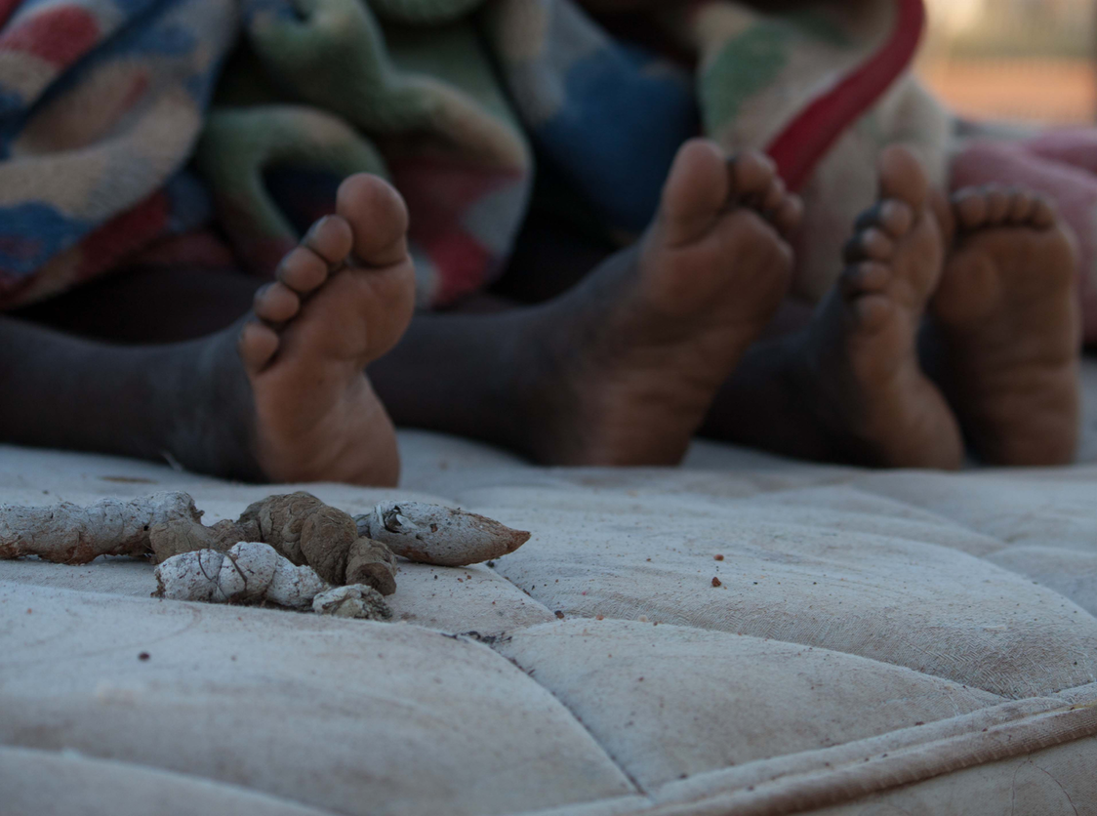
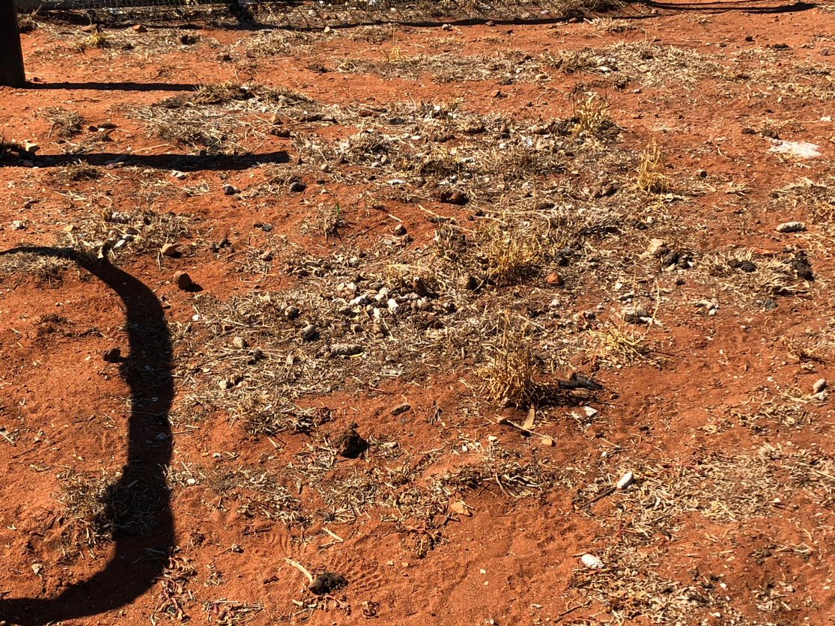
Parvovirus germs live in dirt and animal poo

Slide 10
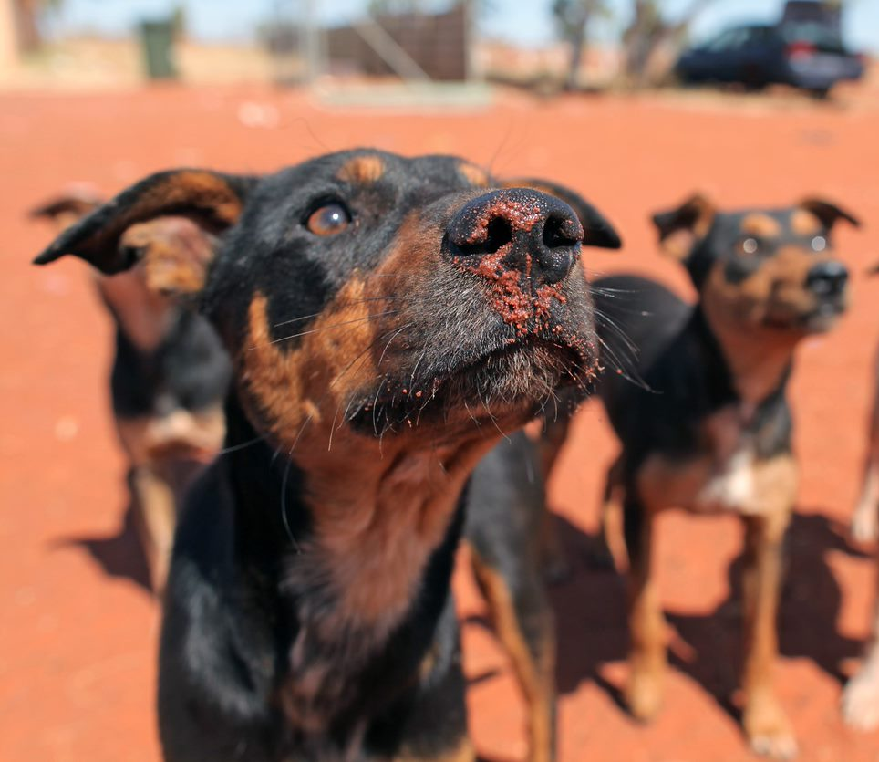
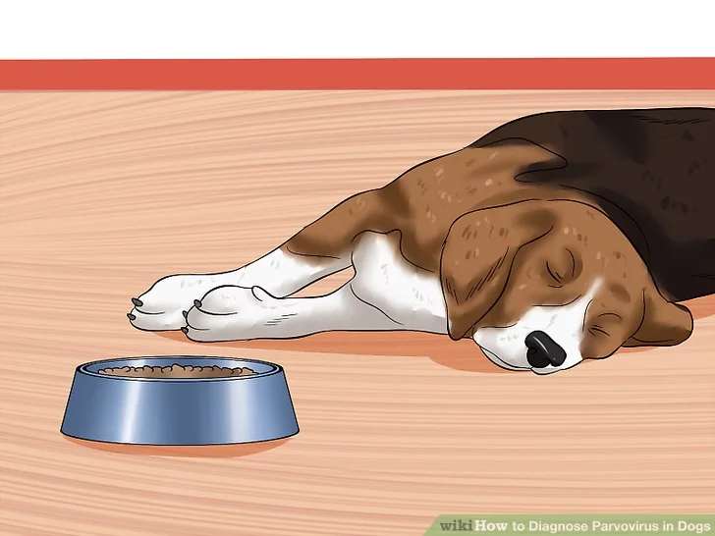

Slide 12
Parvo germs live in
the dirt
Germs make animals sick
Sick animals make people sad

Slide 13
How do we stop parvovirus?
?

Slide 14
Vaccinations

Slide 15
Did you know… Dogs can get vaccinations too!

Slide 16
It is important to get
vaccinated at the right age.

Slide 17
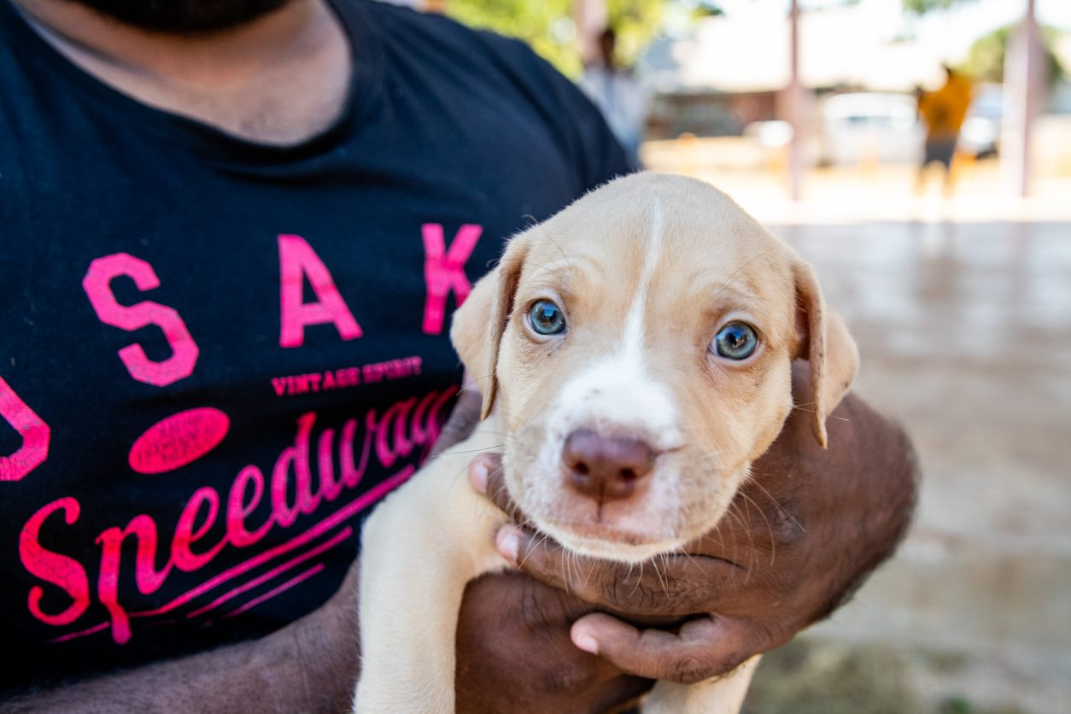
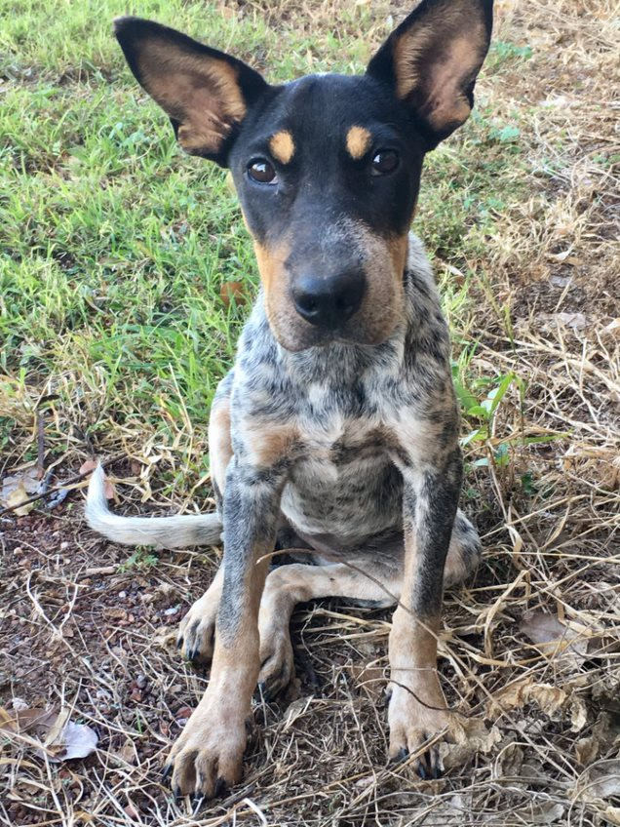
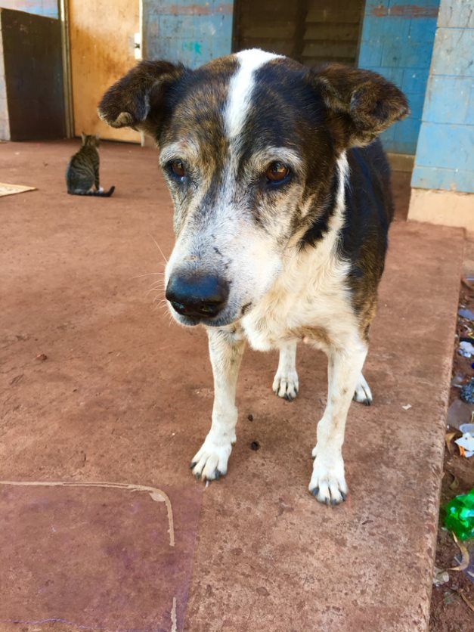
When should your dog get vaccinated against parvo?
A
B
C

Slide 18
Game

Slide 19
When should your dog get vaccinated against parvo?
A
B
C

Slide 20
A

Slide 21
=

