Slide 1
What are we going to talk about today?

Slide 2
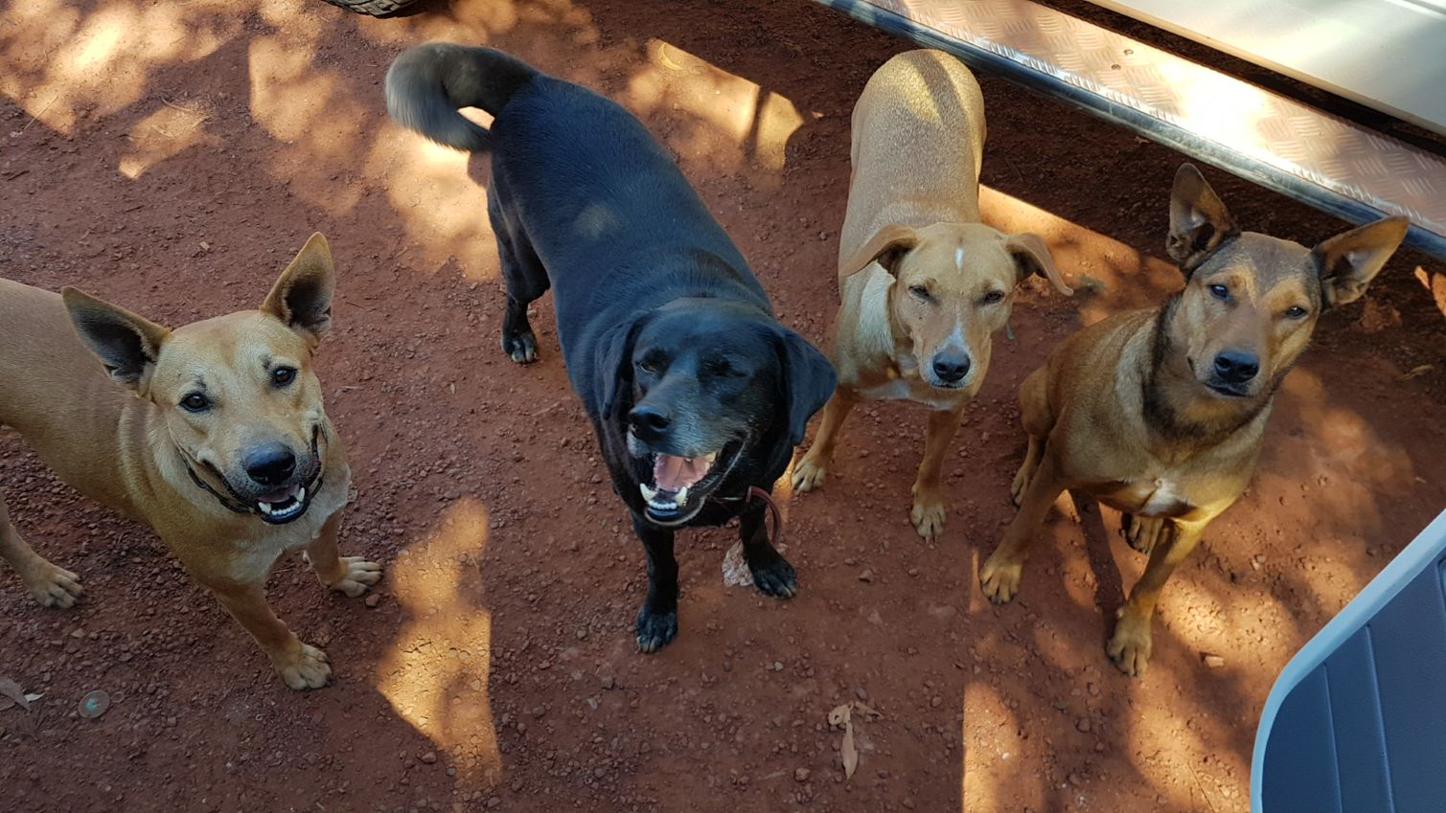

Slide 3
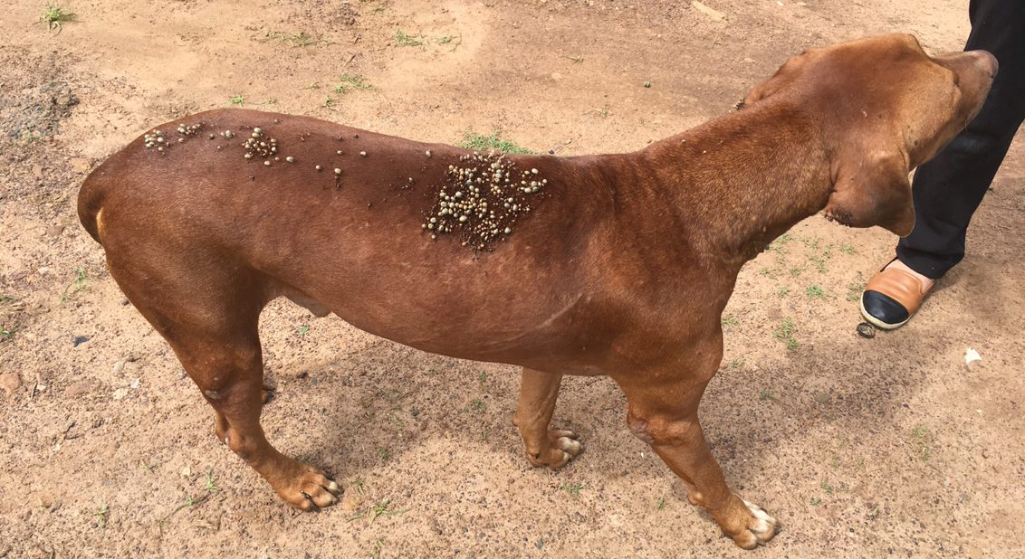
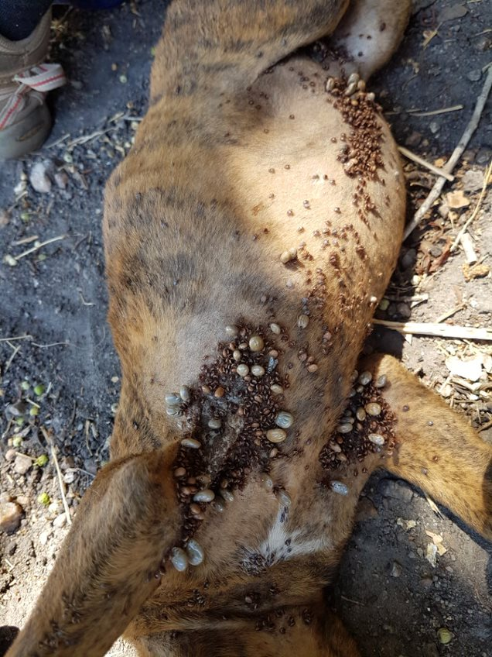
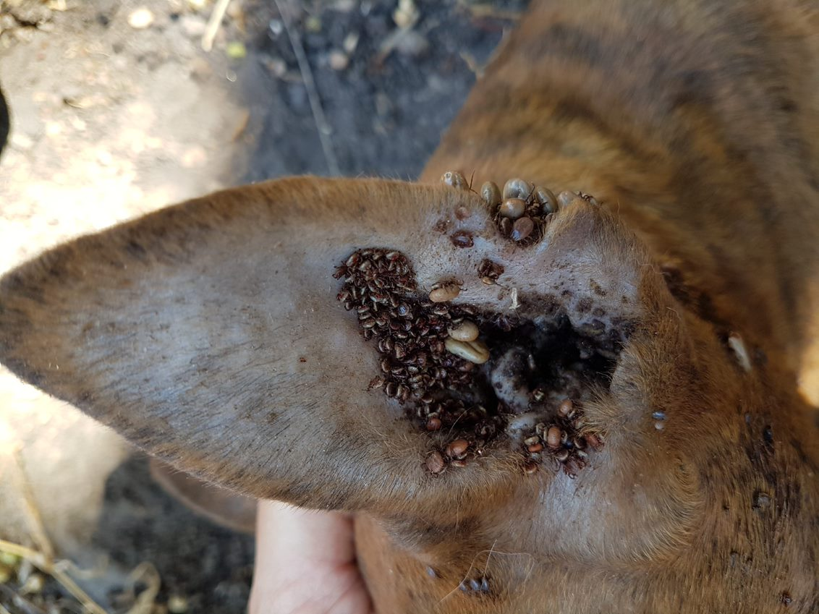

Slide 4
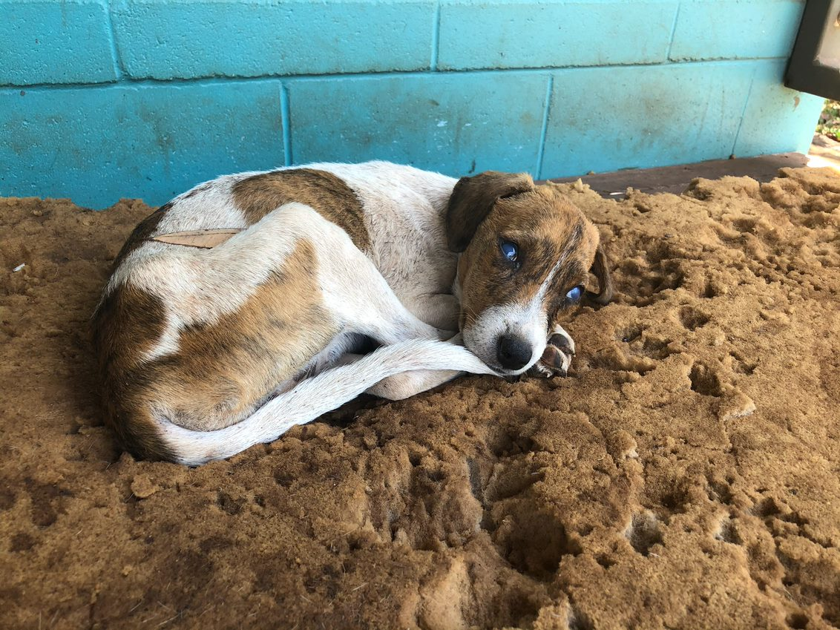
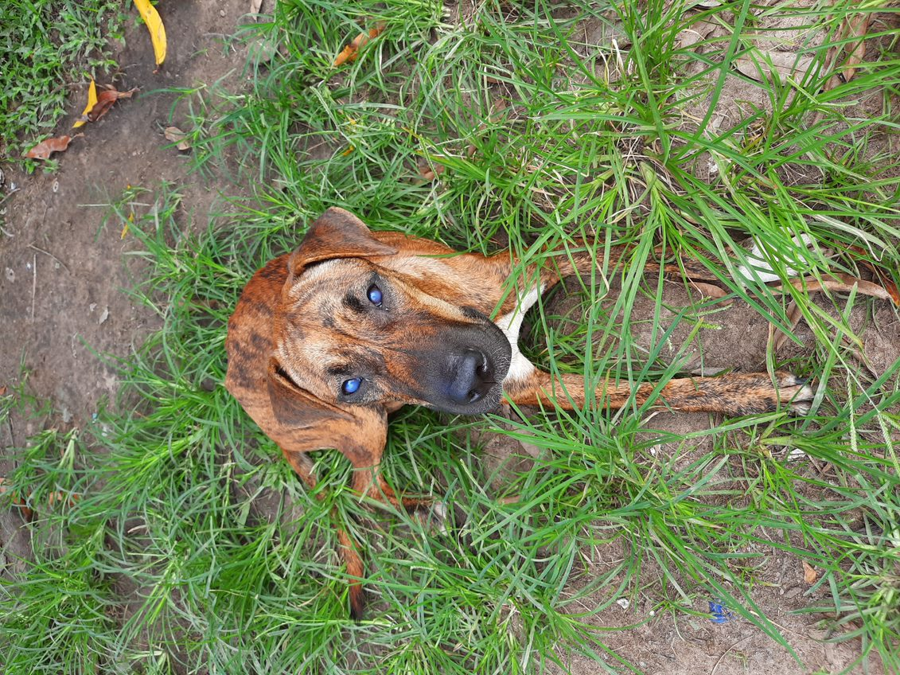
Sad
Skinny
Not want to eat
Blue eyes

Slide 5
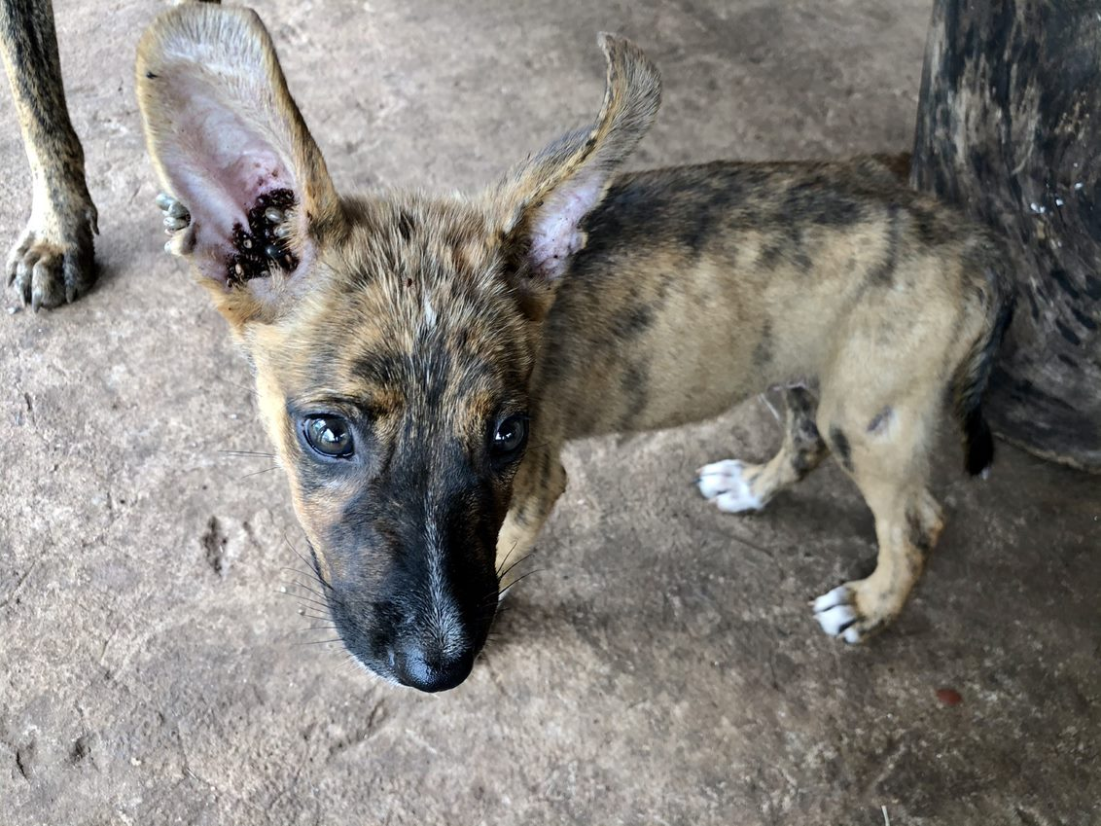
?
+

Slide 6
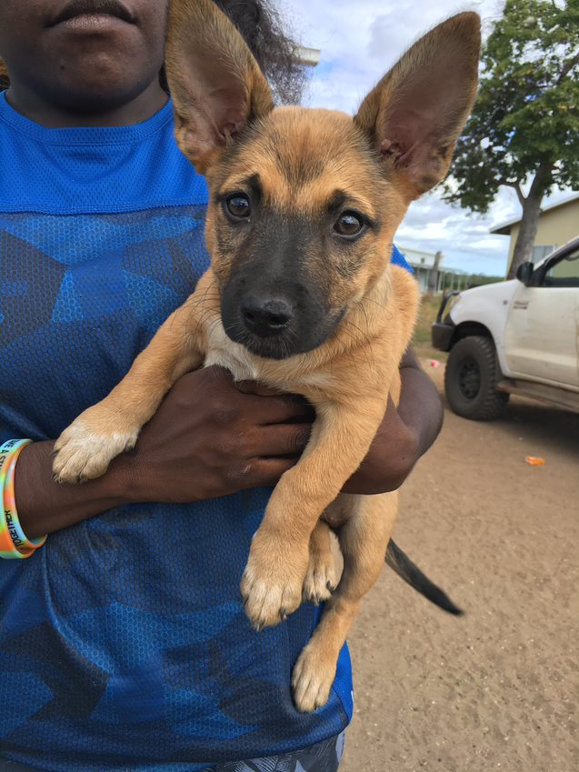
=

Slide 7
?

Slide 8
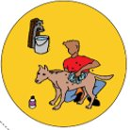
A

Slide 9

B

Slide 10


C

Slide 11
A
B
C

Slide 12
Play video. Link here

Slide 13
Looking Good ? or
Looking Sick?

Slide 14


Slide 15
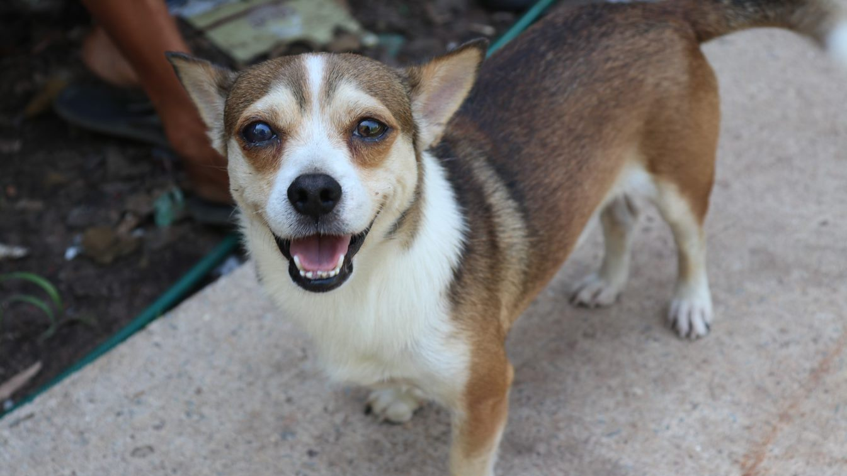

Slide 16
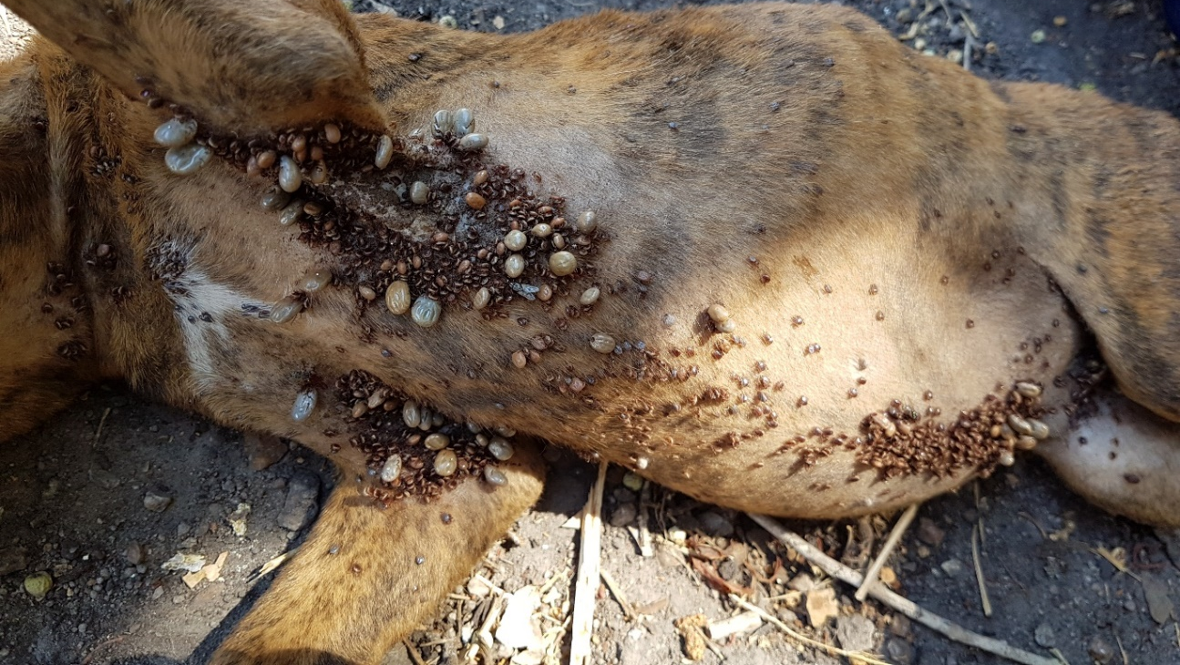

Slide 17
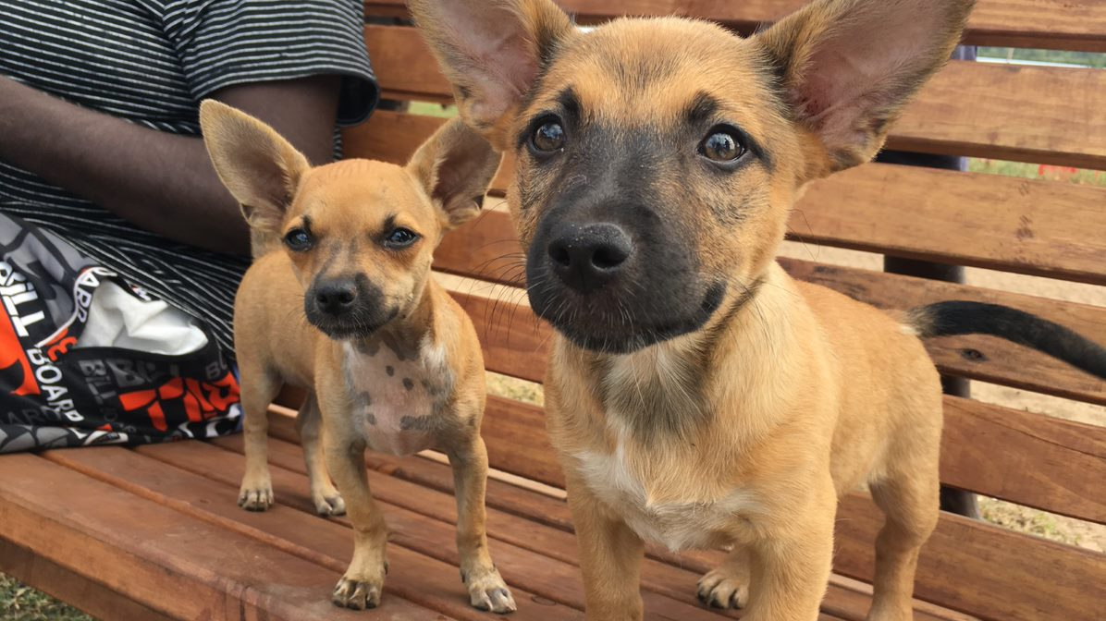

Slide 18
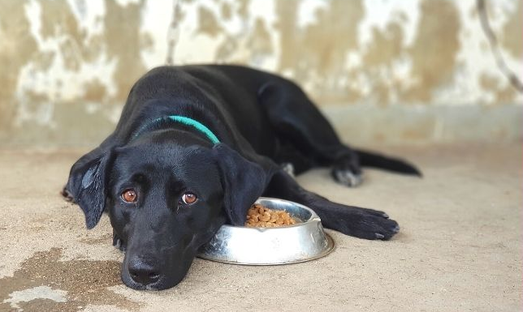

Slide 19
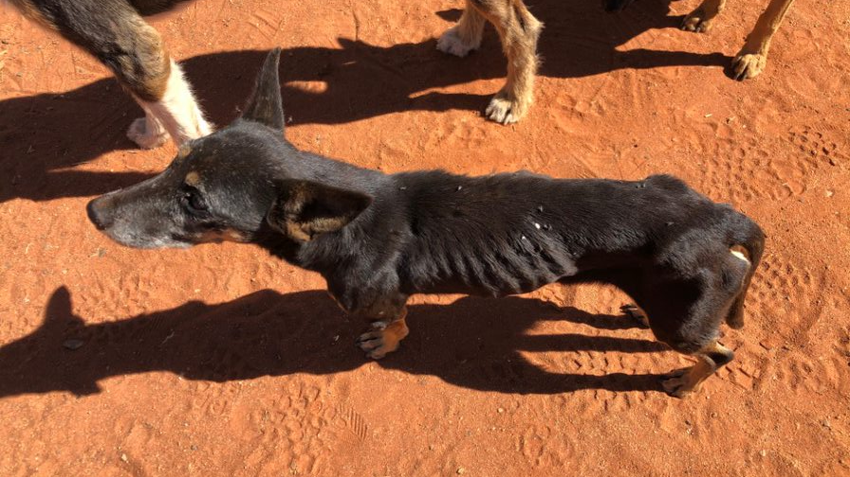

Slide 20
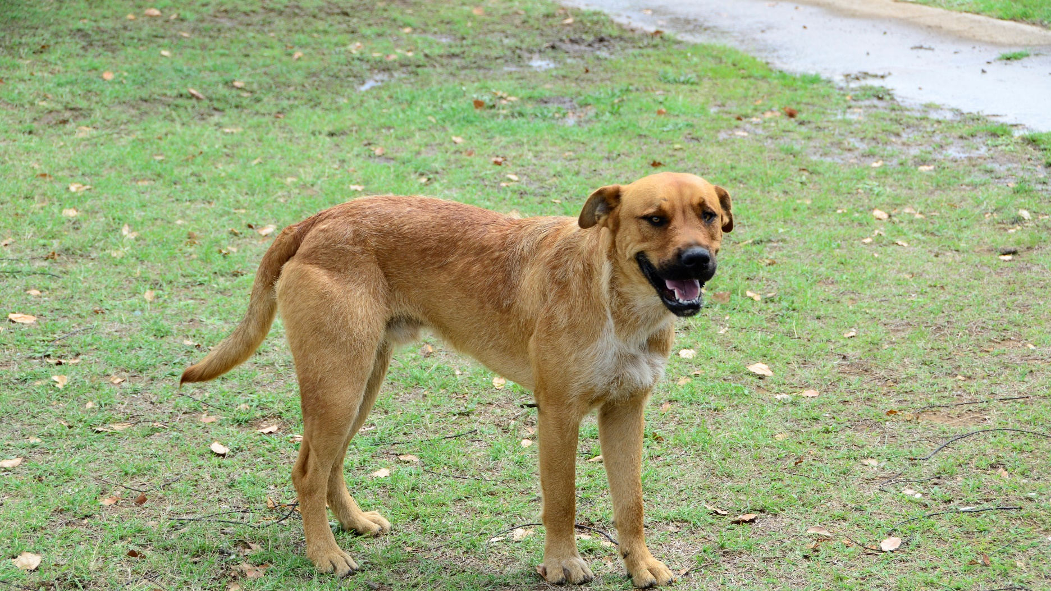

Slide 21
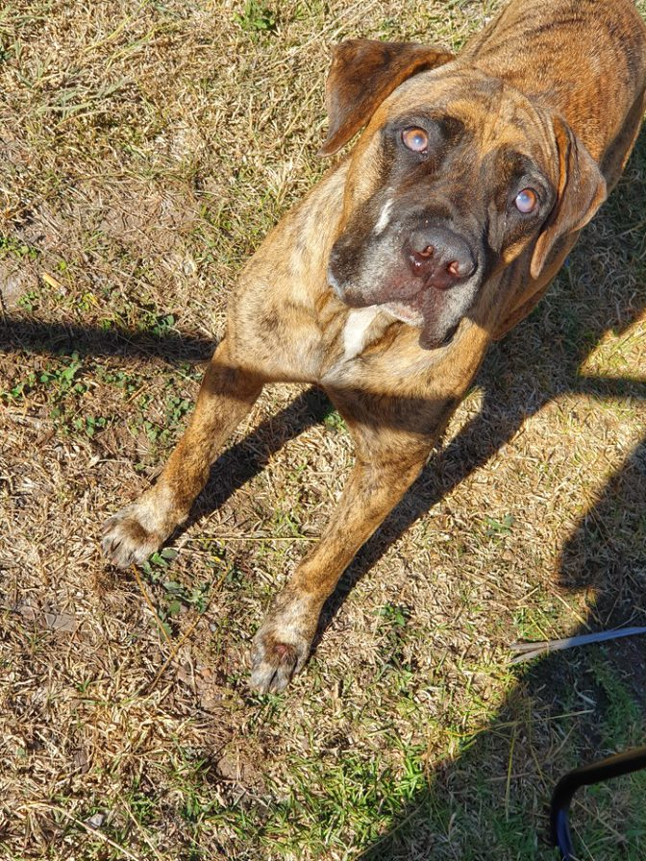

Slide 22
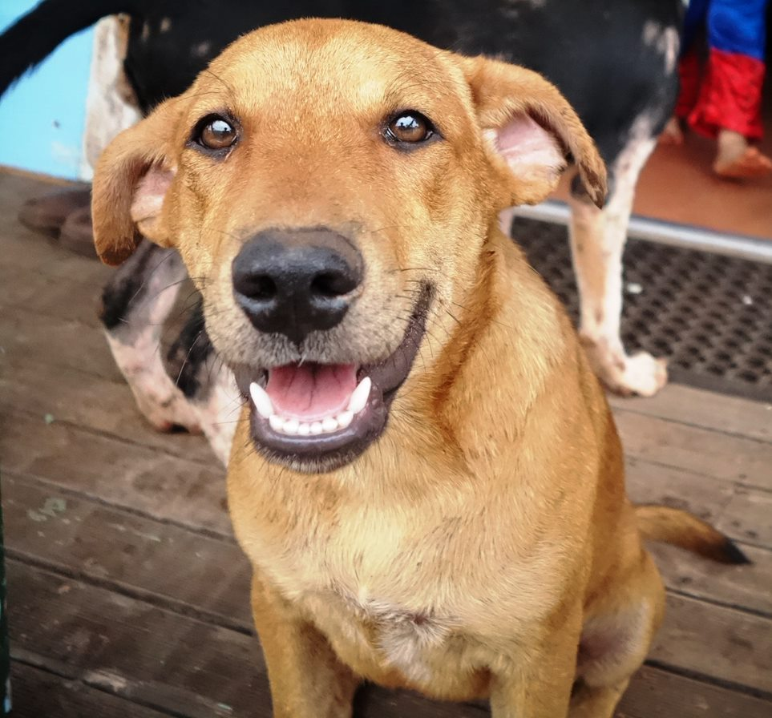

Slide 23
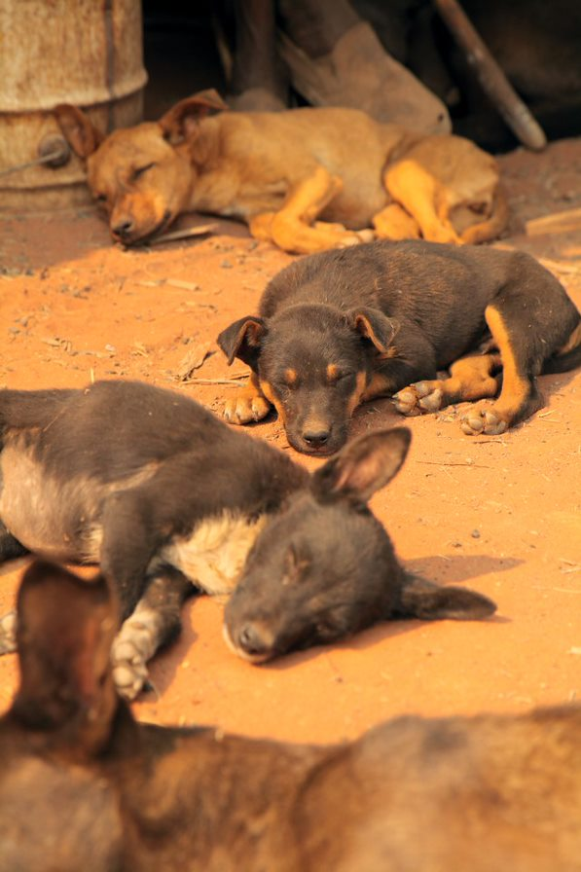

Slide 24
Let’s play again!
Remember the video…🤔
What is the BEST way to stop ticks on your dog?

Slide 25
?
+

Slide 26
=

Slide 27
A
B
C

Slide 28
B

