Slide 1
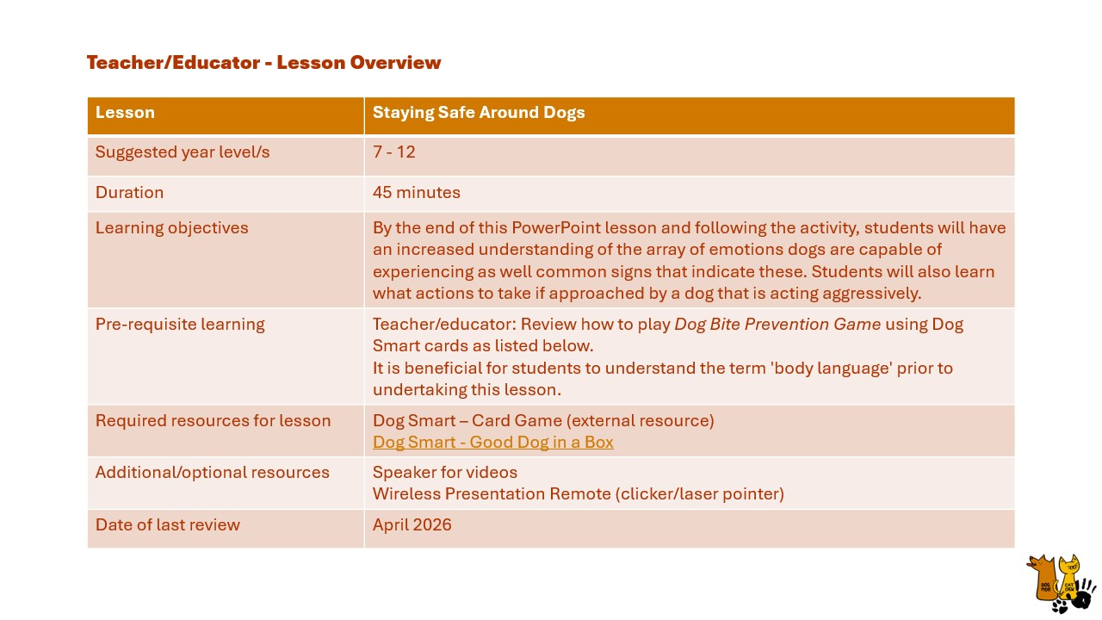
Notes:
Teacher/Educator Lesson Overview

Slide 2

Notes:
Teacher/educator: [Introduce yourself and the lesson topic]
“Staying Safe Around Dogs brought to you by Dog Mob Cat Crew which is AMRRIC’s education mob”
[Ask the students:]
“Does anyone have dogs at home?”

Slide 3
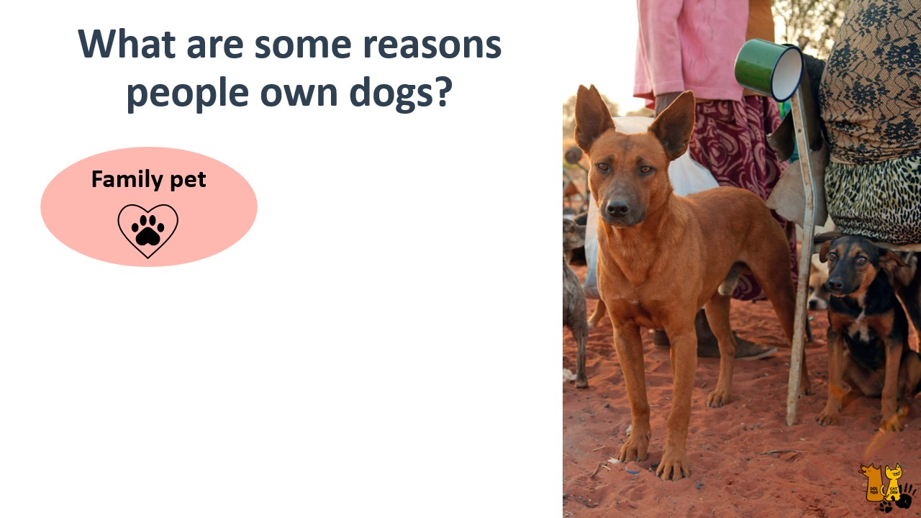
Notes:
Teacher/educator:
“I’d like to start by discussing some of the reasons people own dogs.” “Can anyone list some reasons?” “Why does your family own a dog?”
The following slides contain a further 3 seasons for dog ownership.

Slide 4
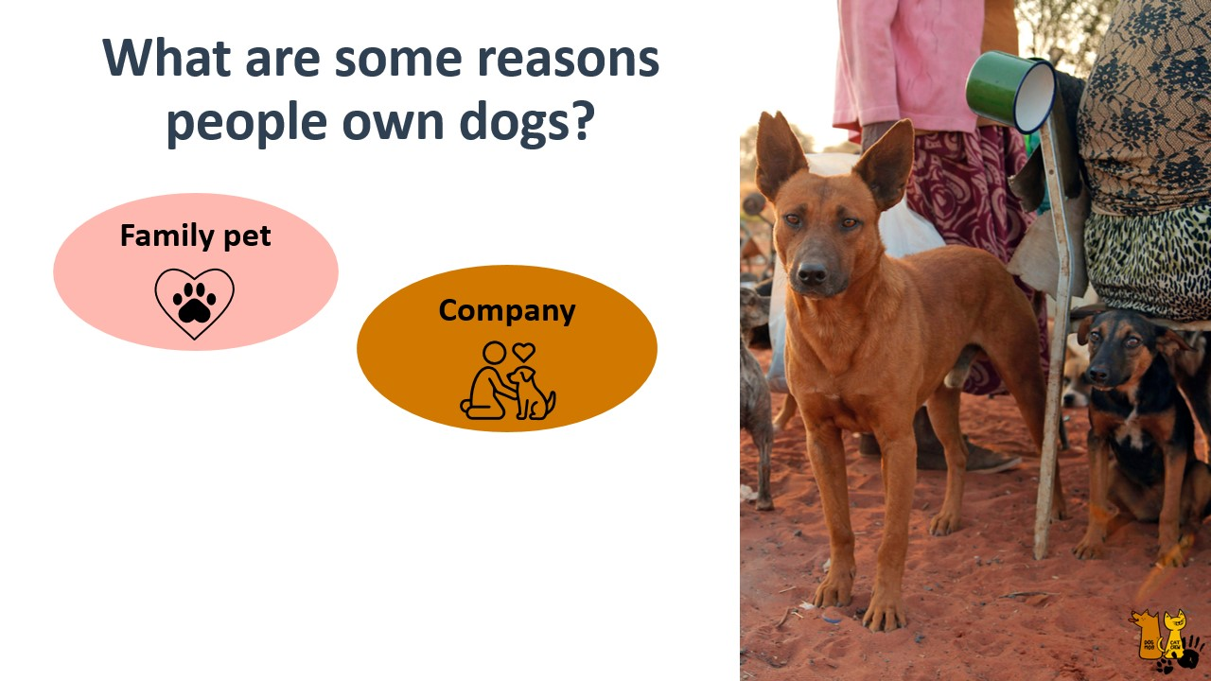
Notes:
Teacher/educator:
“Company”

Slide 5
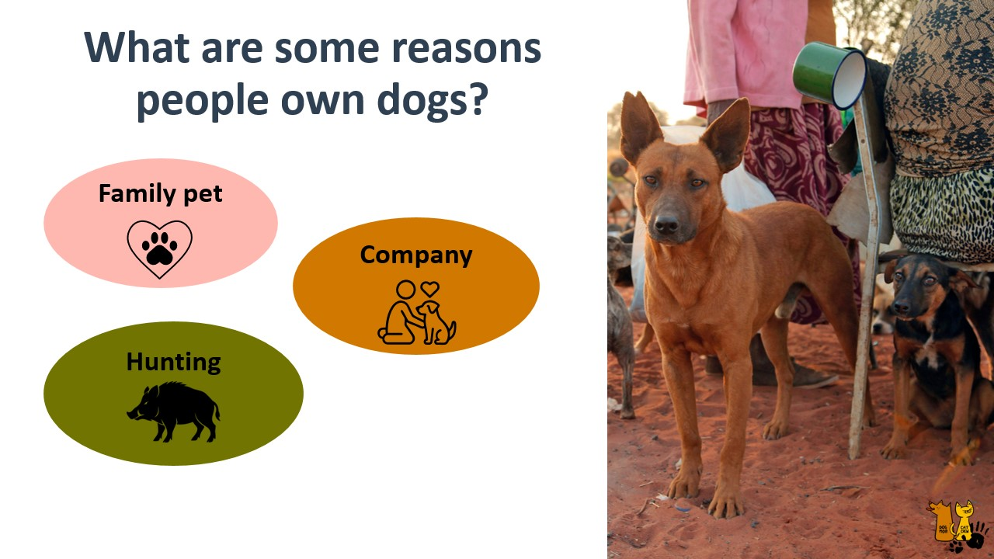
Notes:
Teacher/educator:
“Hunting”

Slide 6
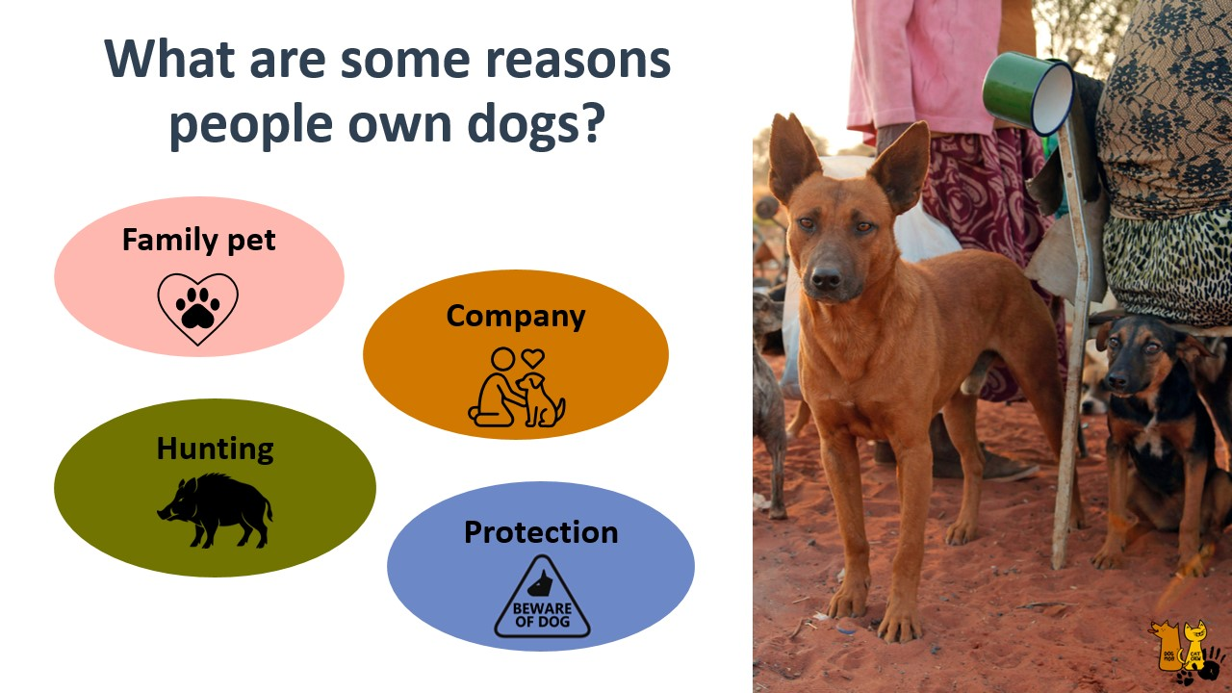
Notes:
Teacher/educator:
“Protection”

Slide 7
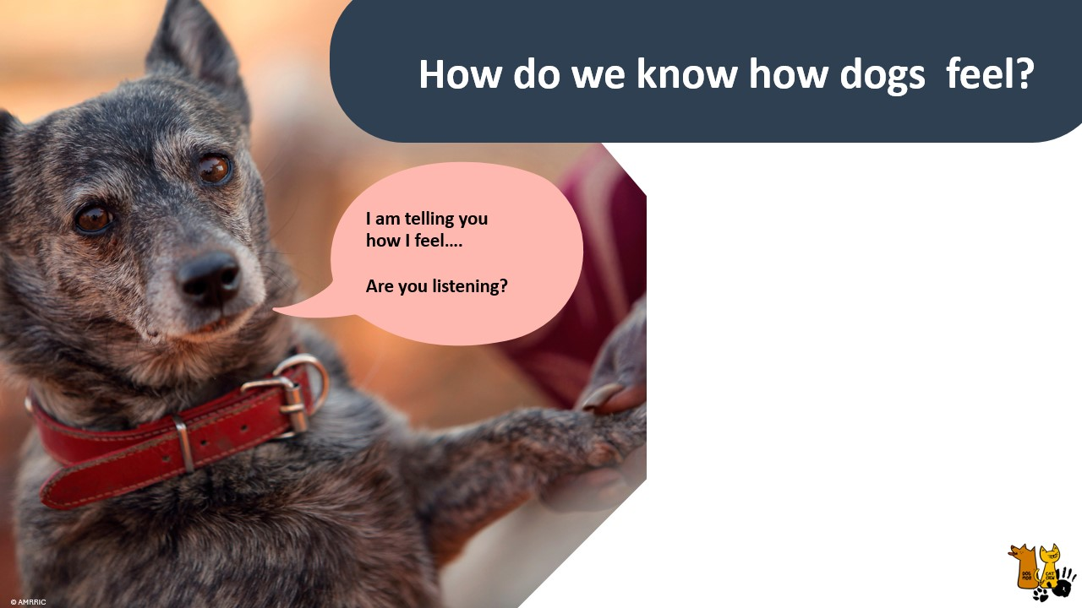
Notes:
Teacher/educator:
“No matter the reasons for owning a dog, we have a responsibility for them and it’s important to understand how they feel so that we can best care for them, but this is also for our safety.
[Ask the students:]
“How do we know how dogs feel? Any ideas? I’ll give you a clue”
“It’s about what we can see a dog doing and…what we can hear. “

Slide 8
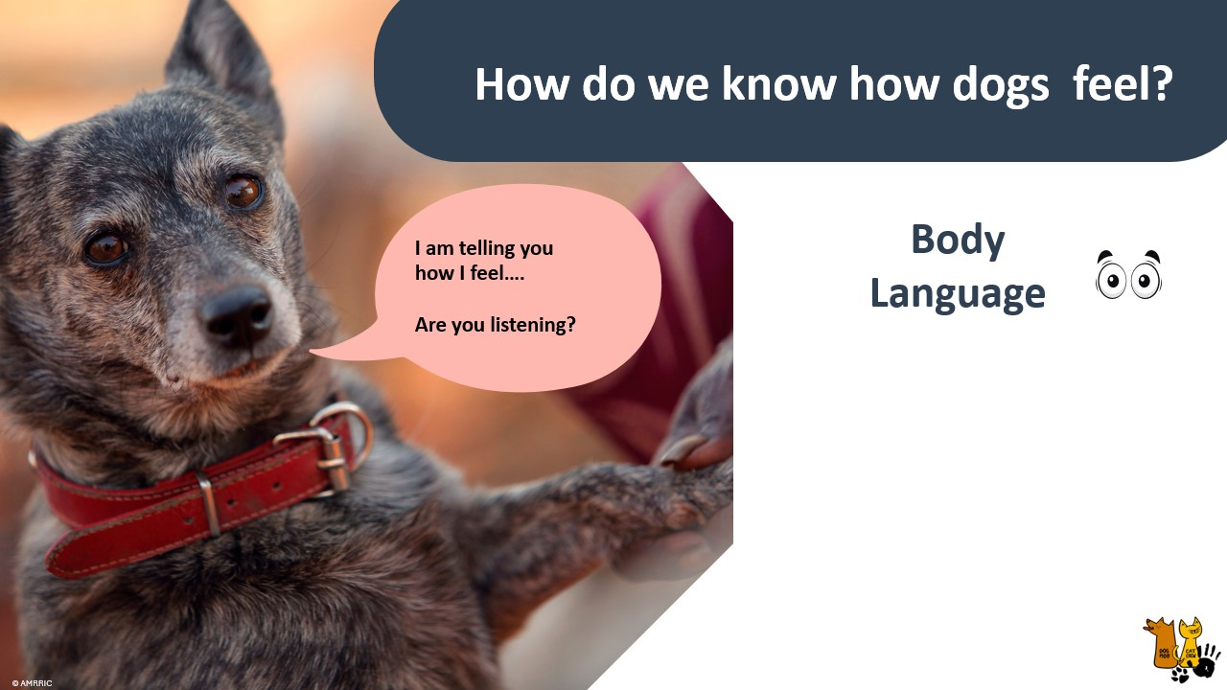
Notes:
Teacher/educator:
“Body language is what we can see they are doing with their bodies”

Slide 9
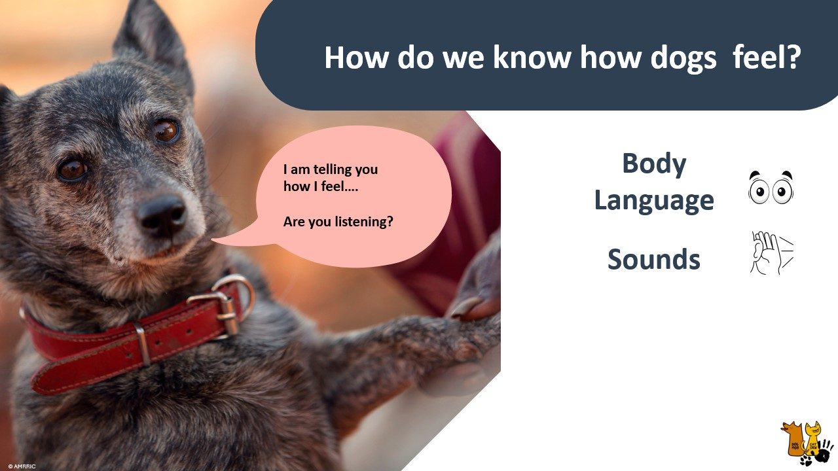
Notes:
Teacher/educator:
”what noises we can hear the dog making”

Slide 10
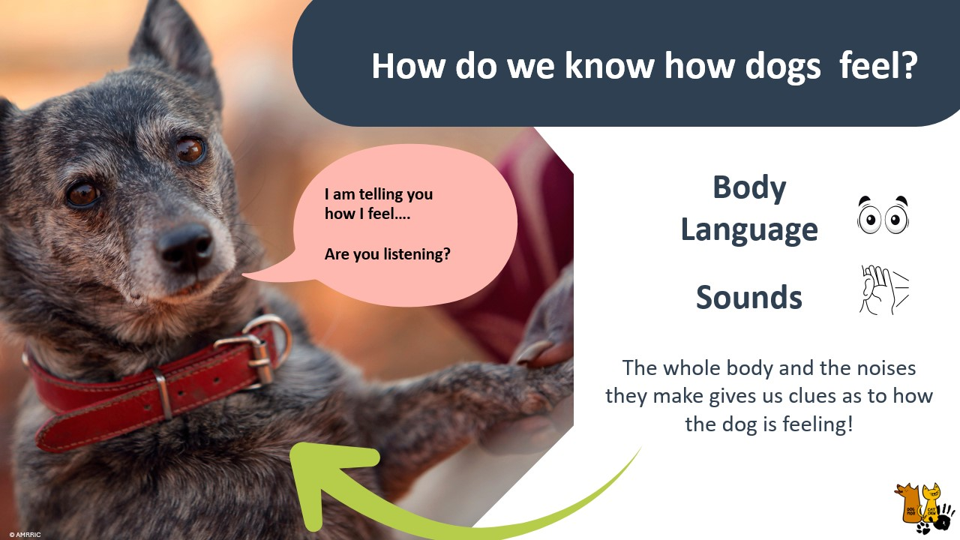
Notes:
Teacher/educator:
“The whole body and the noises they make gives us clues as to how the dog is feeling.“

Slide 11
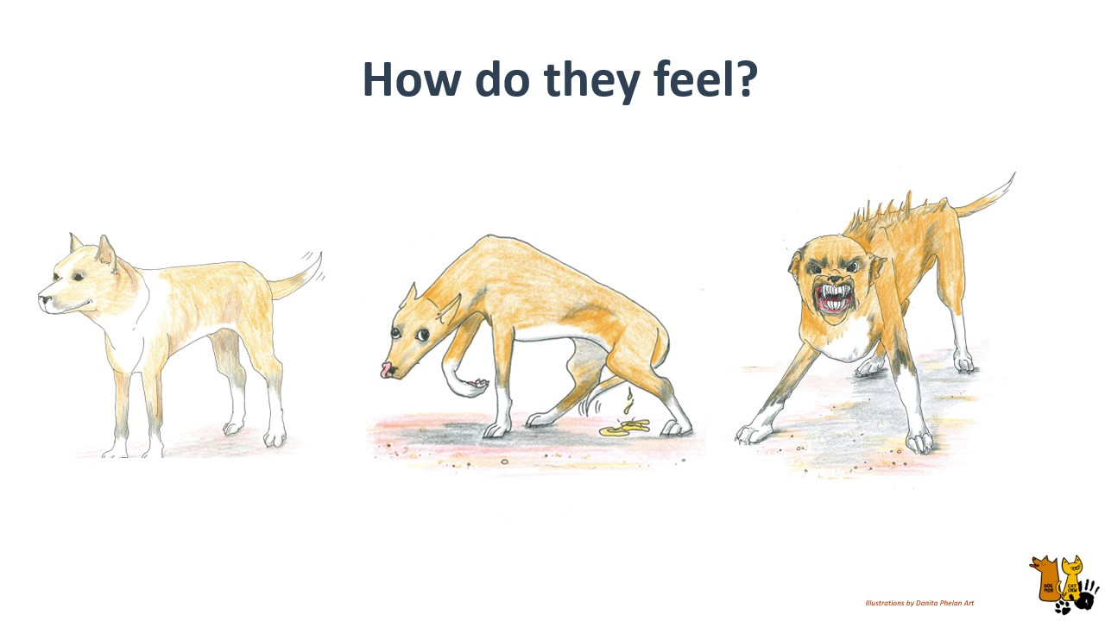
Notes:
Teacher/Educator: “Ok we’ll start with these three. From the body language, what do you think this dog on the left is feeling?”
[Repeat the question for dogs two and three (middle and right) before revealing visiting the next slide.

Slide 12
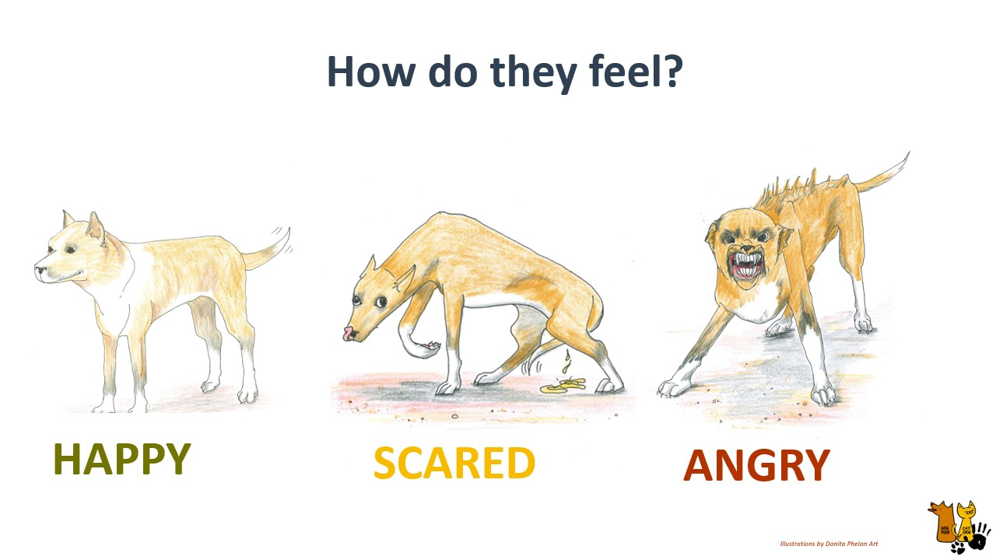
Notes:
Teacher/educator:
“So we can see that overall the body language displayed would indicate that these dogs feel: happy, scared and angry”

Slide 13
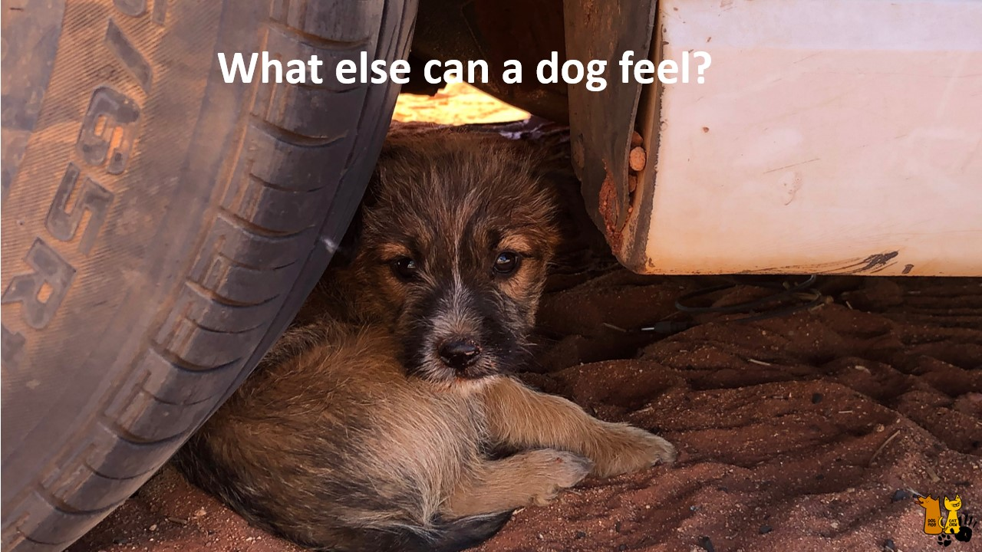
Notes:
Teacher/educator: “Ok so we’ve got happy, scared and angry. Does anyone want to try and guess some other emotions a dog is capable of experiencing?”
“Does anyone have very young brothers or sisters? Dogs feelings is said to be similar to what a very young child can feel. A child about the age of 2 years or 2.5 years old”
References accessed April 2026: Do Dogs Really Have Emotions? The Science Explained – ScienceInsights Do Dogs Really Have Emotions? The Science Explained – ScienceInsights
Do Dogs Feel? A Happy Dog Expert Explains! | ADAPTILWhat Emotions Do Dogs Feel? A Happy Dog Expert Explains! | ADAPTIL

Slide 14
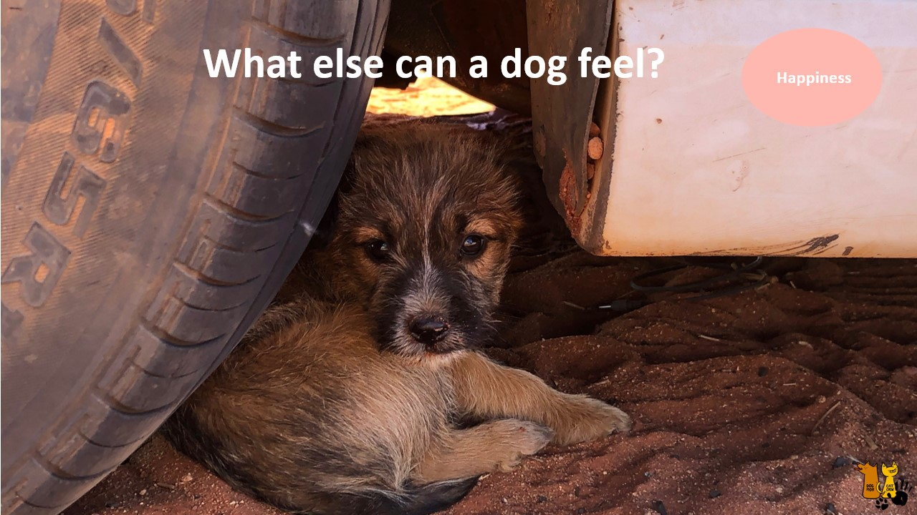
Notes:
Teacher/educator:
“happiness”

Slide 15
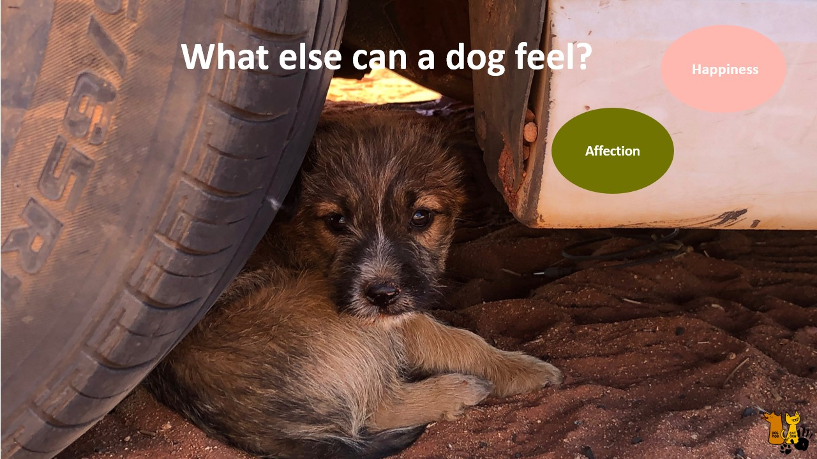
Notes:
Teacher/educator:
“Affection”

Slide 16
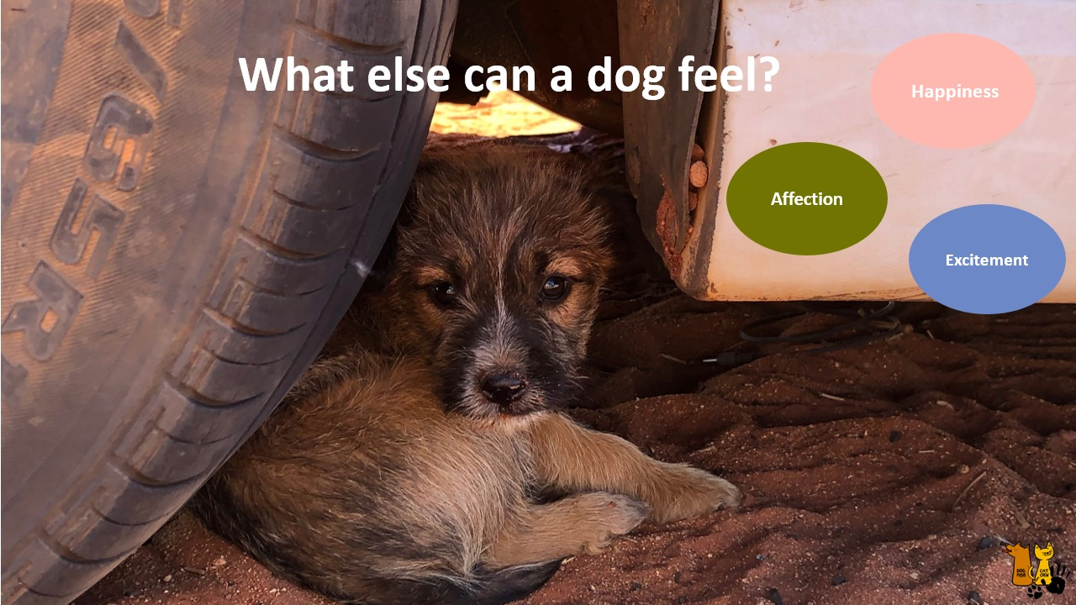
Notes:
Teacher/educator:
“Excitement”

Slide 17
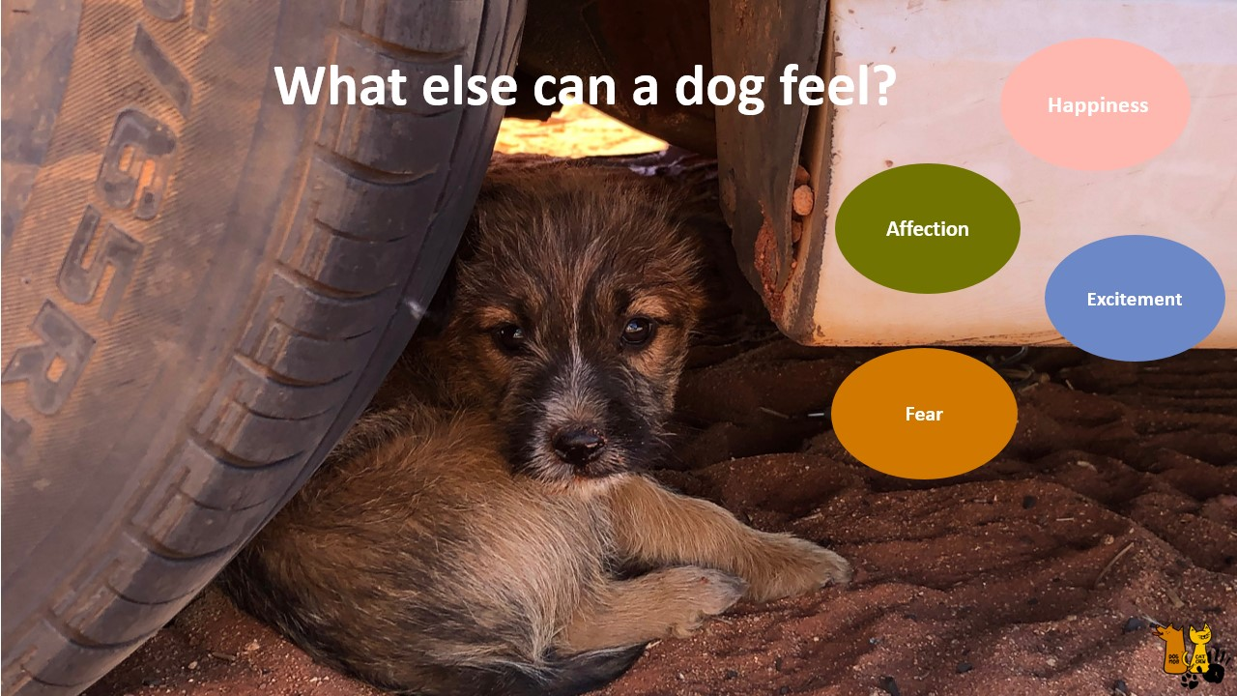
Notes:
Teacher/educator:
“Fear”

Slide 18
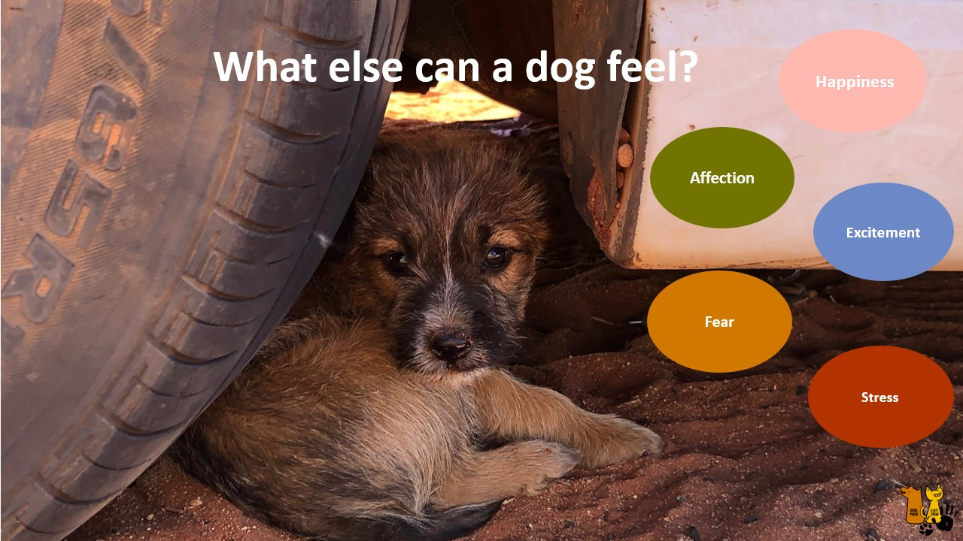
Notes:
Teacher/educator:
“Stress”

Slide 19
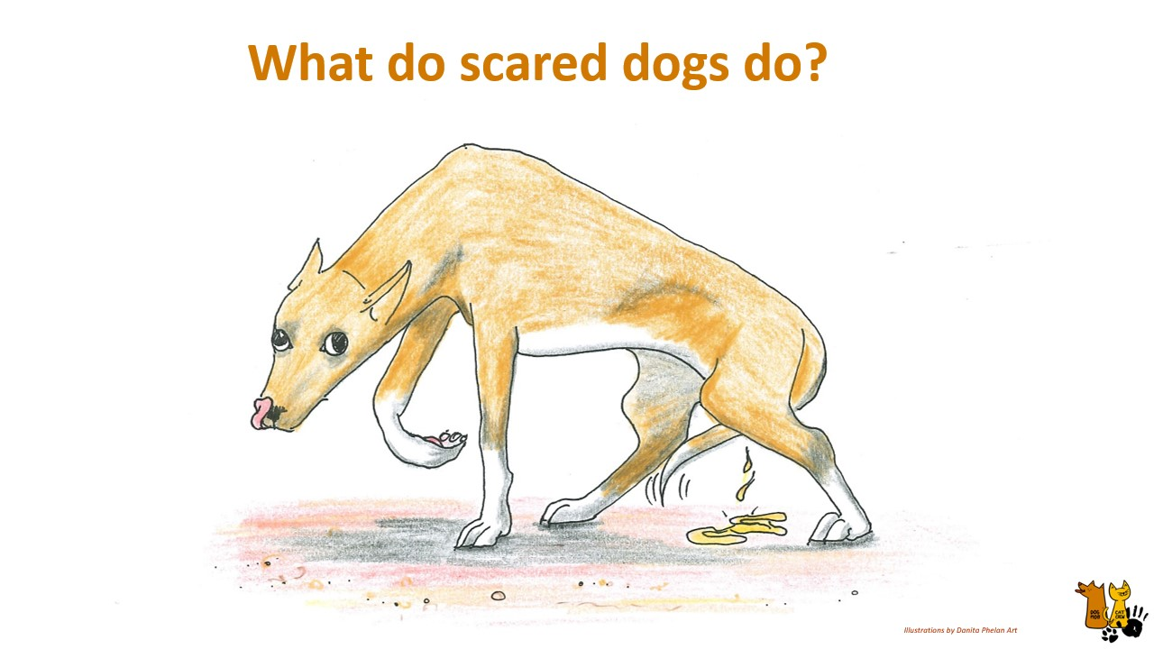
Notes:
Teacher/Educator: “We are going to spend a little bit of time focusing on scared dogs because they can be difficult to understand and sometimes the signs that a dog is feeling scared, are very subtle.”
“I’d like to ask you…What do Scared dogs look like?​ What can you see?”

Slide 20
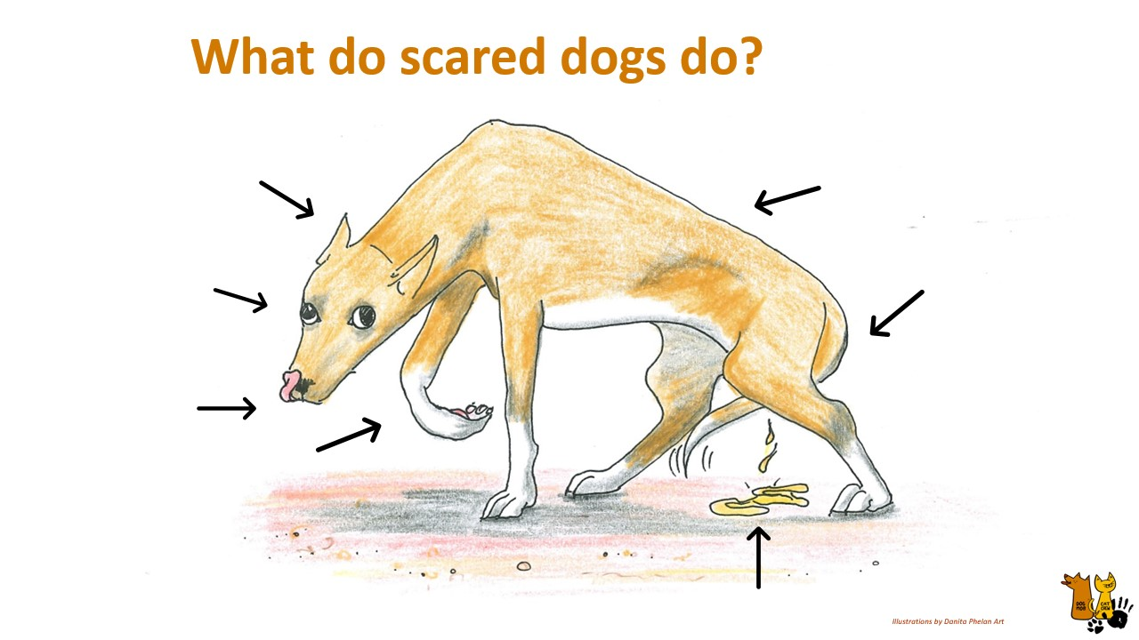
Notes:
Teacher/educator:
“This dog as an example is showing a lof of the common signs we see a scared dog displaying so we’ll go through each of these”

Slide 21
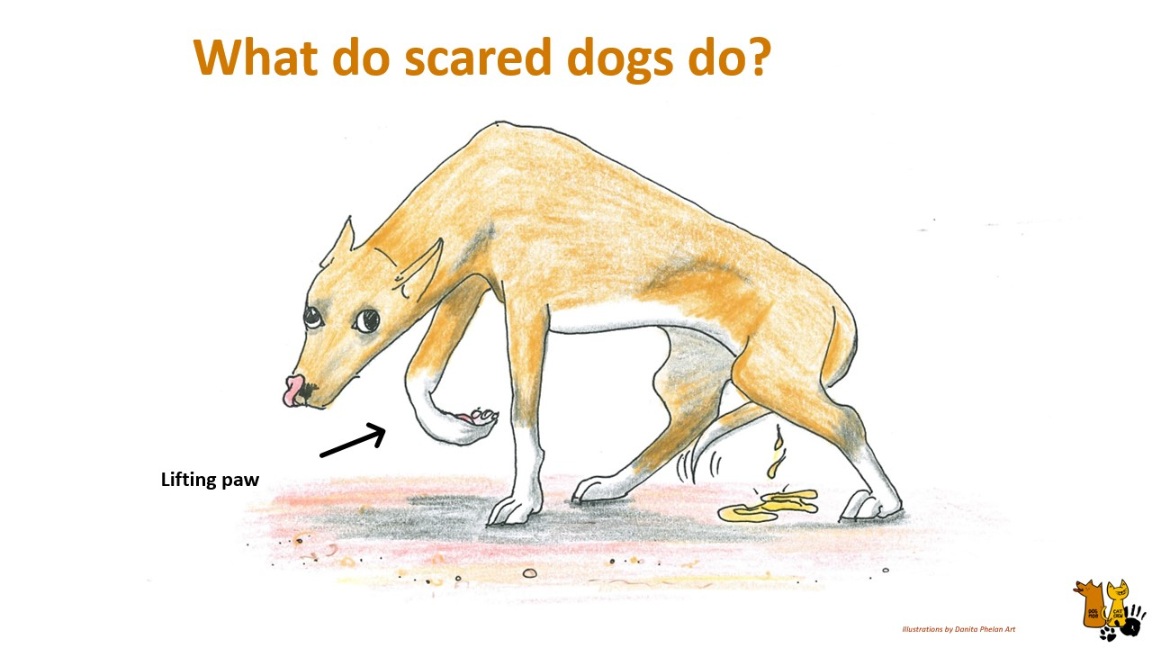
Notes:
Teacher/educator:
“Lifting paw”

Slide 22

Notes:
Teacher/educator:
“Licking”

Slide 23
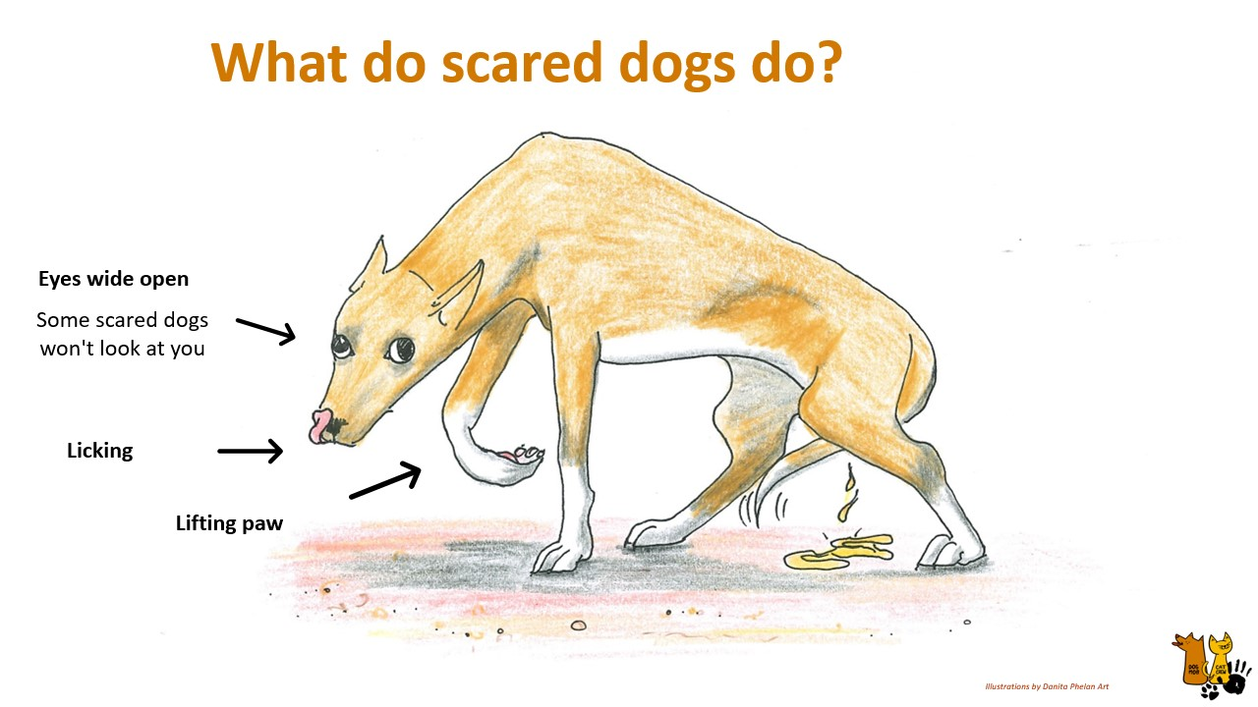
Notes:
Teacher/educator:
“Wide eyes, sometimes you can see the white of their eyes or, they can also have really wide eyes but not be making any eye contact with you”

Slide 24
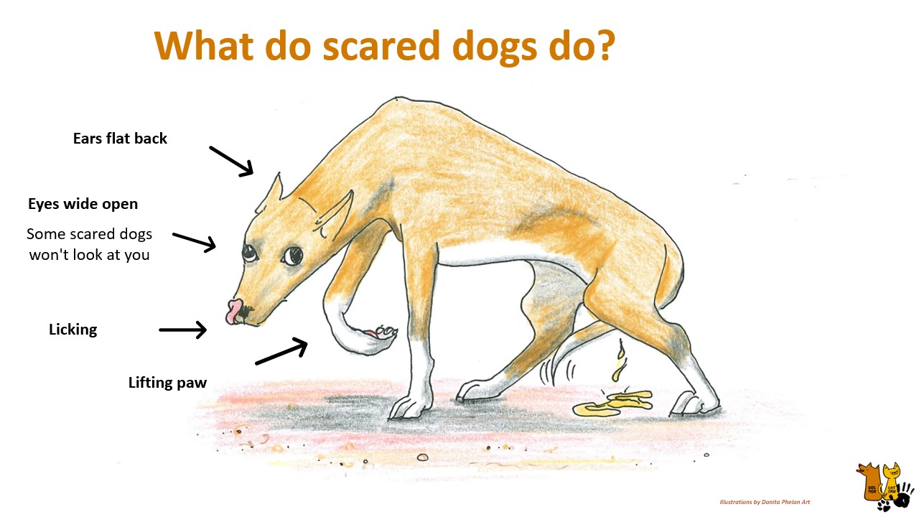
Notes:
Teacher/educator:
“ears flat back”

Slide 25
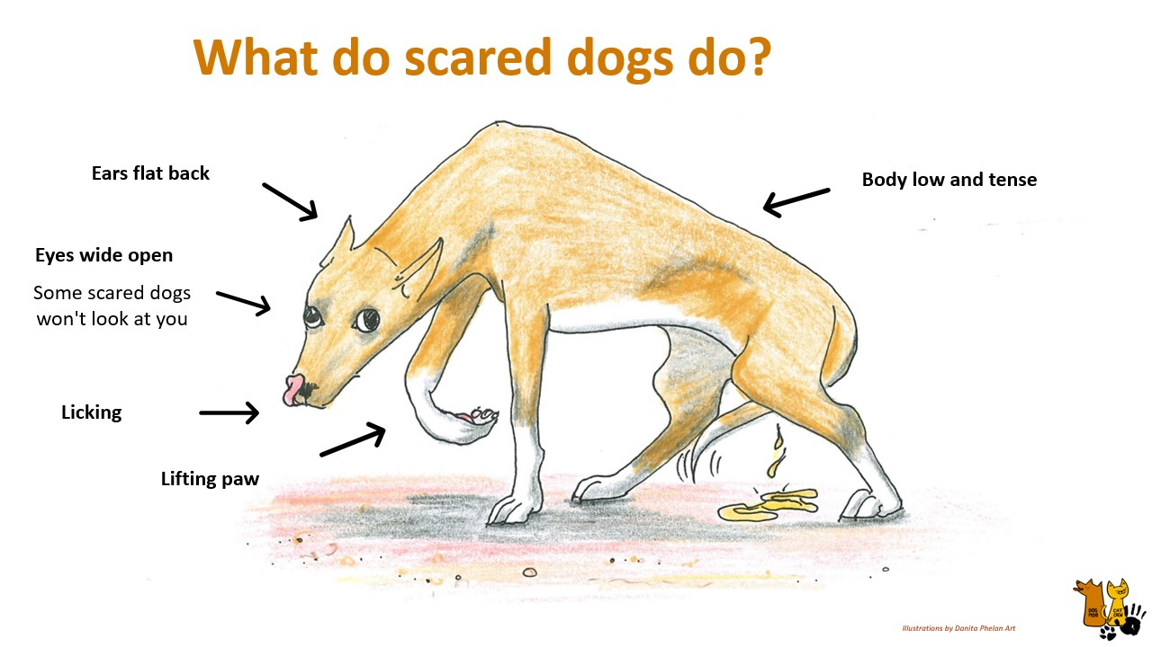
Notes:
Teacher/educator:
“body low and tense”

Slide 26
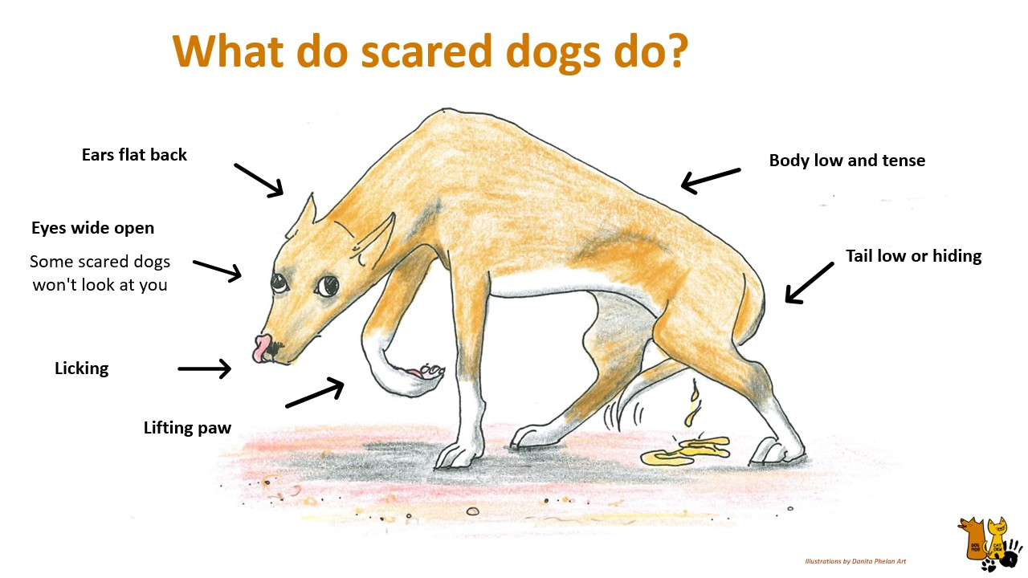
Notes:
Teacher/educator:
“Tail low or hiding”

Slide 27
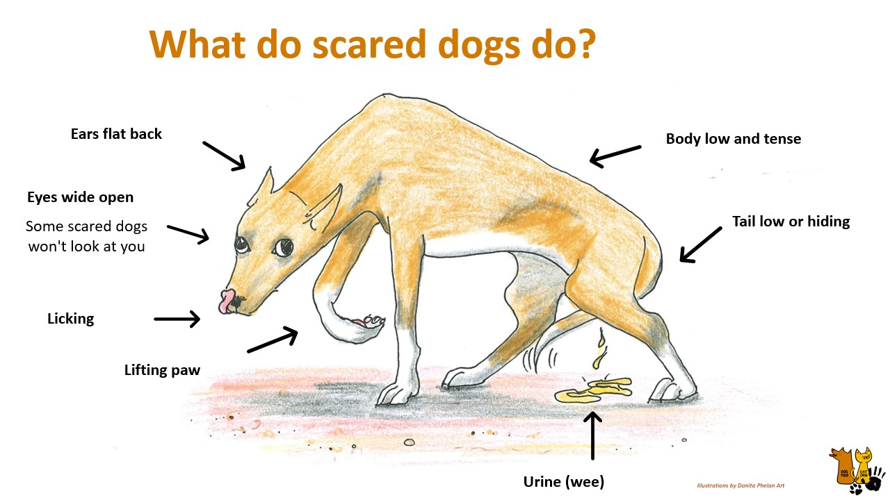
Notes:
Teacher/educator:
“urinating or defaecating”

Slide 28
Notes:
Teacher/educator:
“urinating or defaecating”

Slide 29
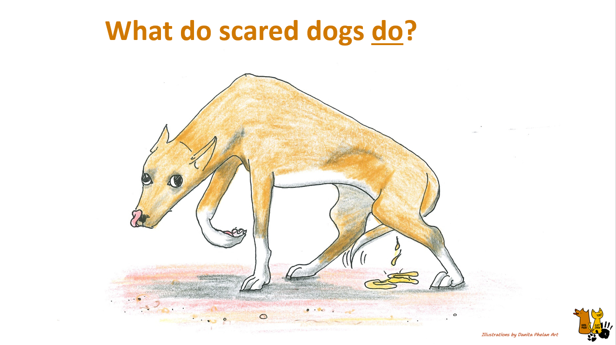
Notes:
Teacher/educator:
“What do scared dog do?” “Their behaviour”

Slide 30
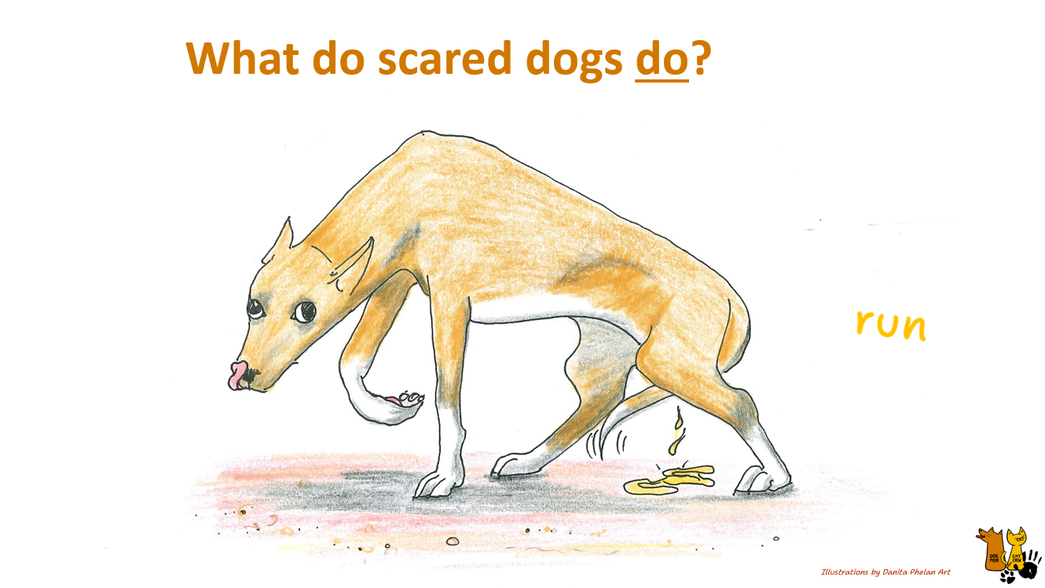
Notes:
Teacher/educator:
“Run”

Slide 31
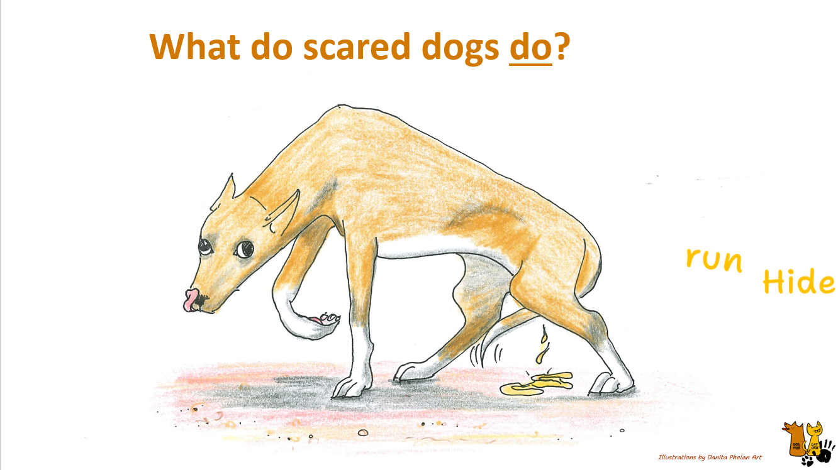
Notes:
Teacher/educator:
“Hide”

Slide 32
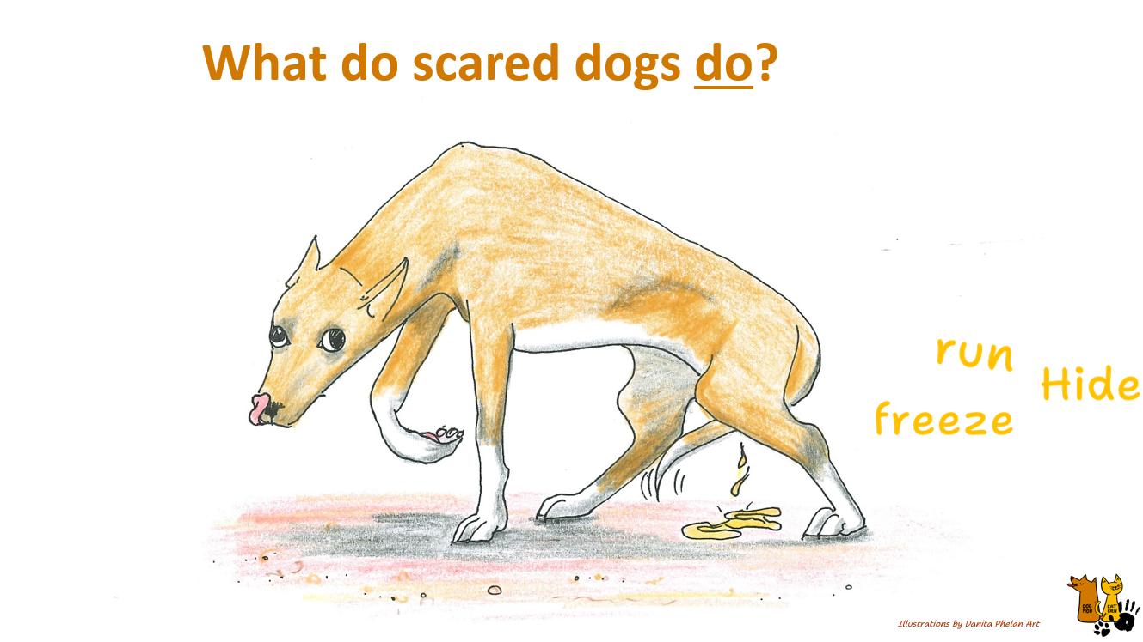
Notes:
Teacher/educator:
“Freeze”

Slide 33
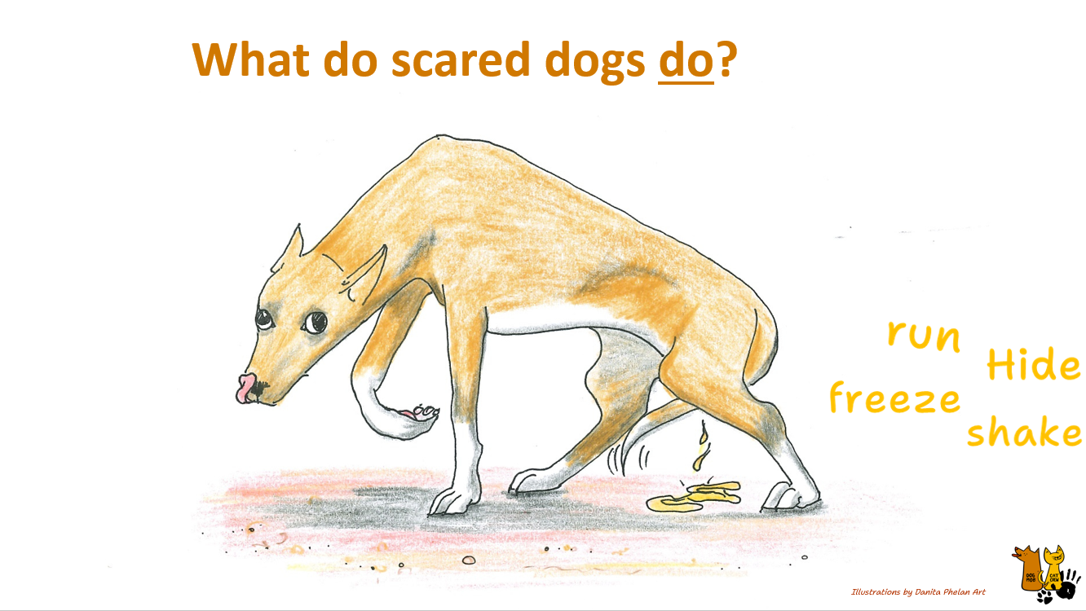
Notes:
Teacher/educator:
“Shake”

Slide 34
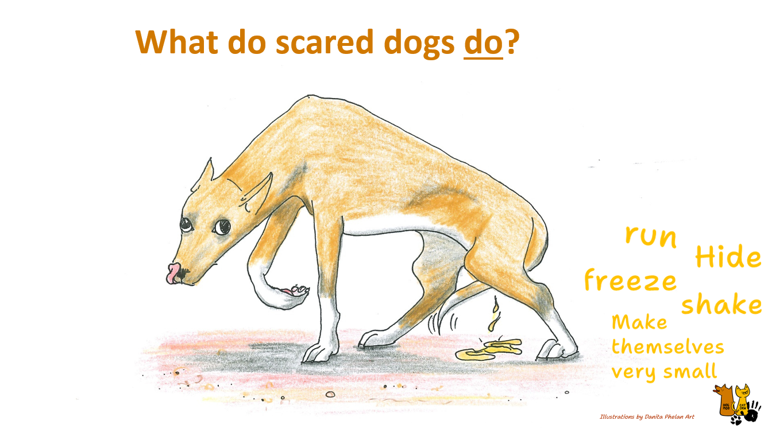
Notes:
Teacher/educator:
“make themselves very small”

Slide 35
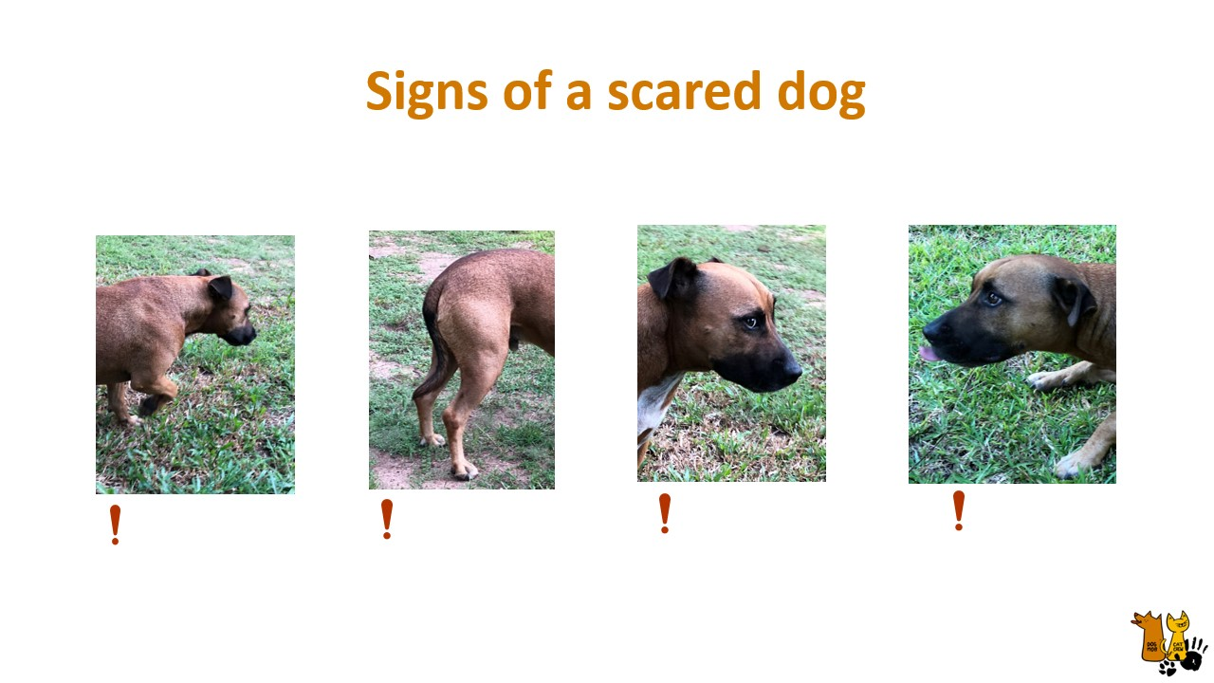
Notes:
Teacher/educator: “Ok we are going to see if we can identify some of those signs on this dog.” “Looking at each of these images, there’s going to be one sign in each image – lets see if we can guess them all”
[Go through each image with the students]
“What sign can we see?”

Slide 36

Notes:
Teacher/educator:
“Raising paw”

Slide 37
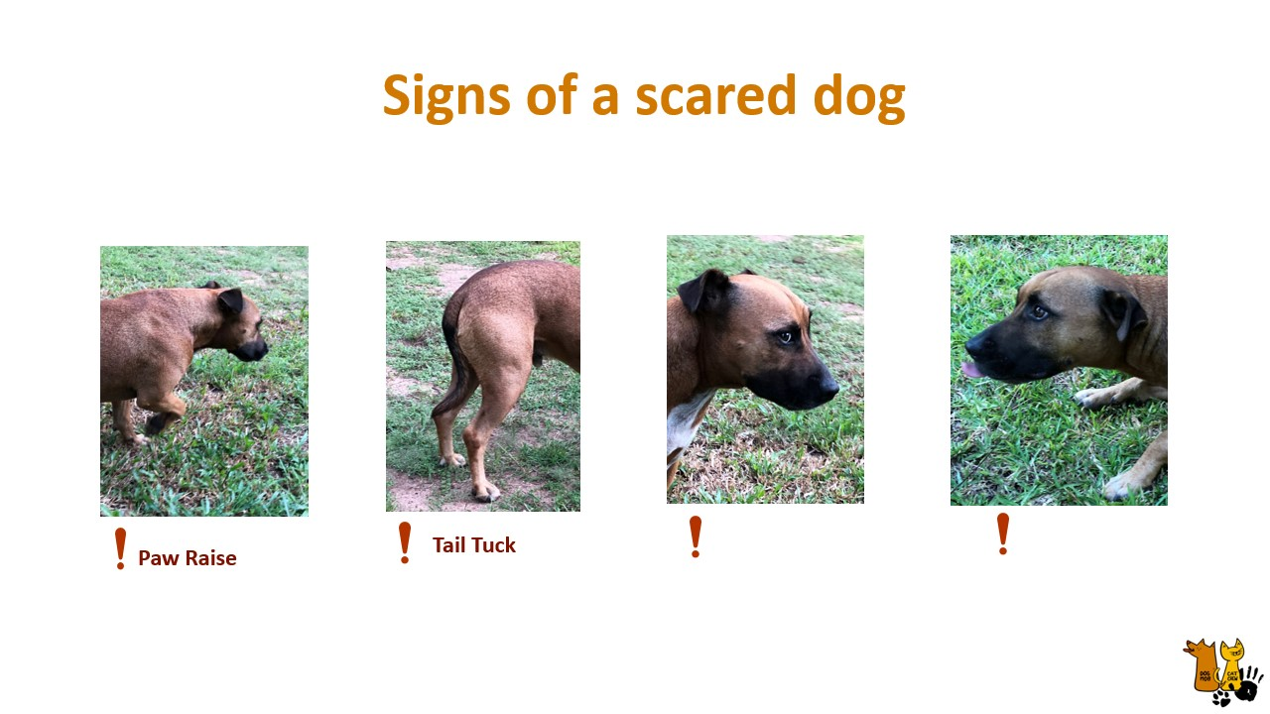
Notes:
Teacher/educator:
“Tail tucked”

Slide 38

Notes:
Teacher/educator:
“Wide eyes – we see they white of this dogs eye”

Slide 39

Notes:
Teacher/educator:
“Licking”

Slide 40
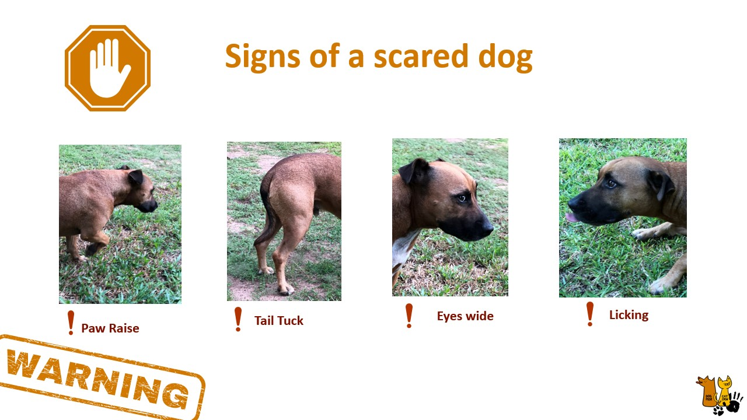
Notes:
Teacher/educator:
“Should we approach this dog?” “What do you think could happen if we did?”

Slide 41
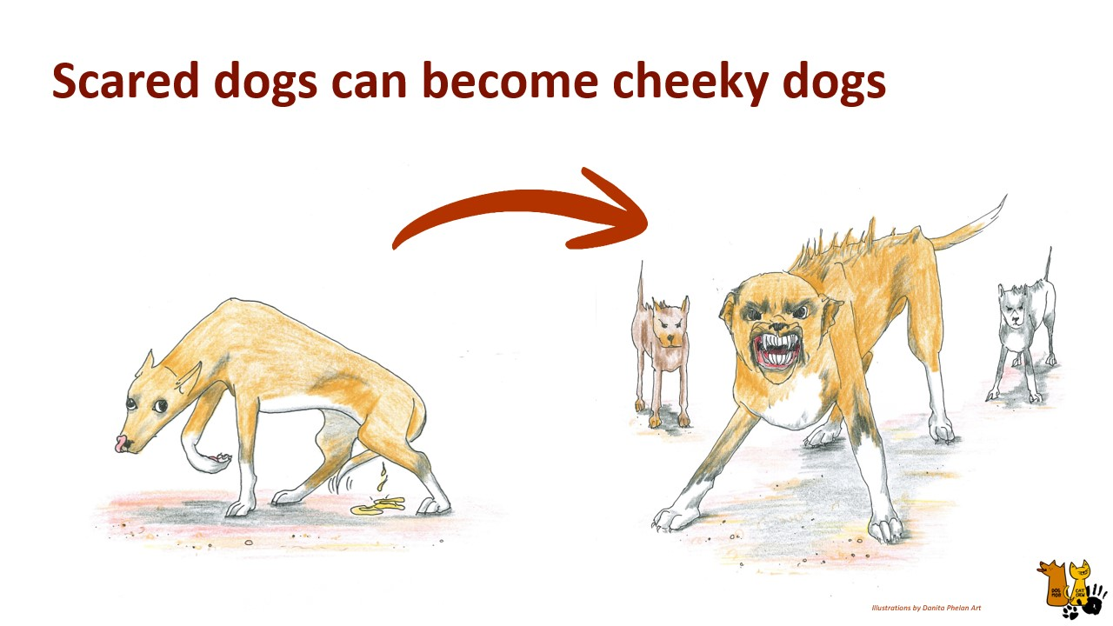
Notes:
Teacher/educator: “Scared dogs can become aggressive/cheeky, quickly. So if we see the signs of a dog being scared we should give the dog some space to calm down.”

Slide 42
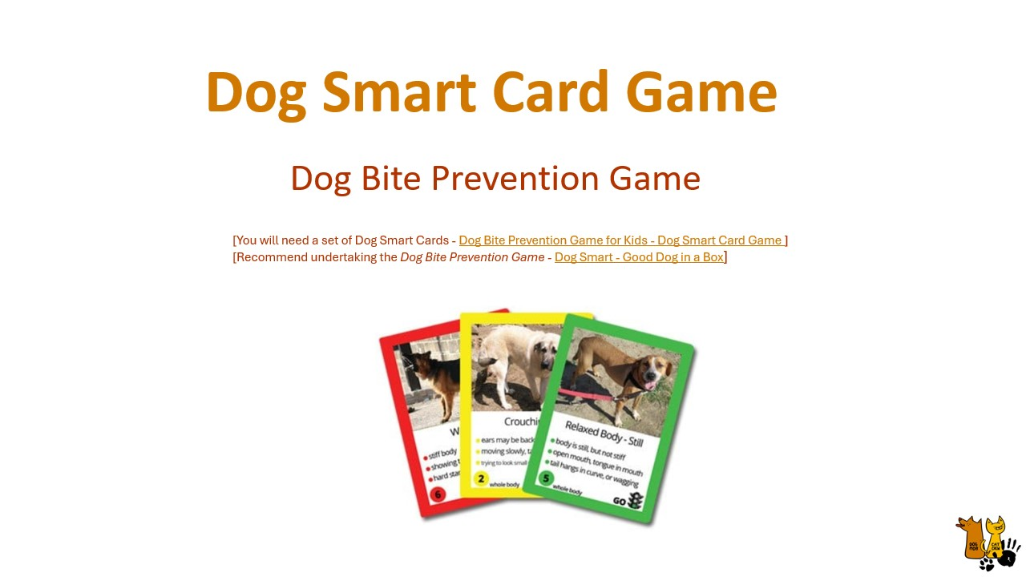
Notes:
Teacher/educator: “Ok we are going to play a game to practice identifying dogs body language/ signs.”
[You will need a set of Dog Smart Cards - Dog Bite Prevention Game for Kids - Dog Smart Card Game ]
[Recommend undertaking the Dog Bite Prevention Game - Dog Smart - Good Dog in a Box]

Slide 43
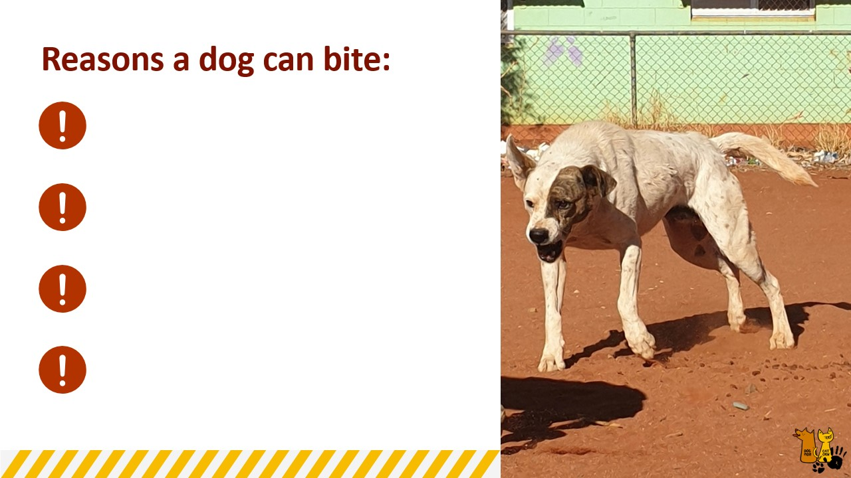
Notes:
Teacher/educator: “We now know many of the signs that suggests a dog is feeling happy/relaxed, scared or angry.”
“Can anyone give me some examples of when a dog can bite and why they might do this?” “Understanding why dogs bite is important for preventing future bites”

Slide 44
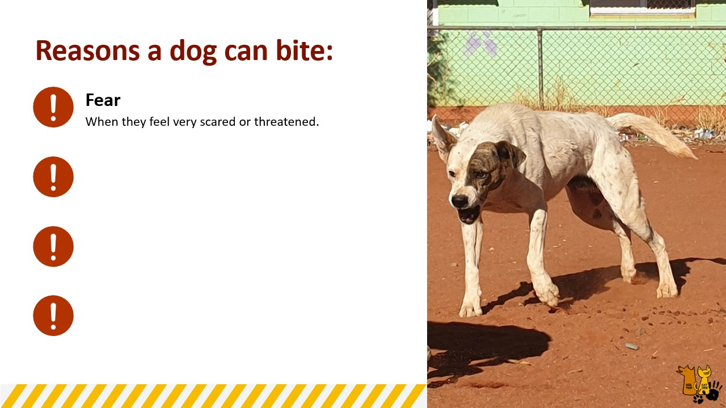
Notes:
Teacher/educator:
“Fear – when they feel very scared or threatened”

Slide 45
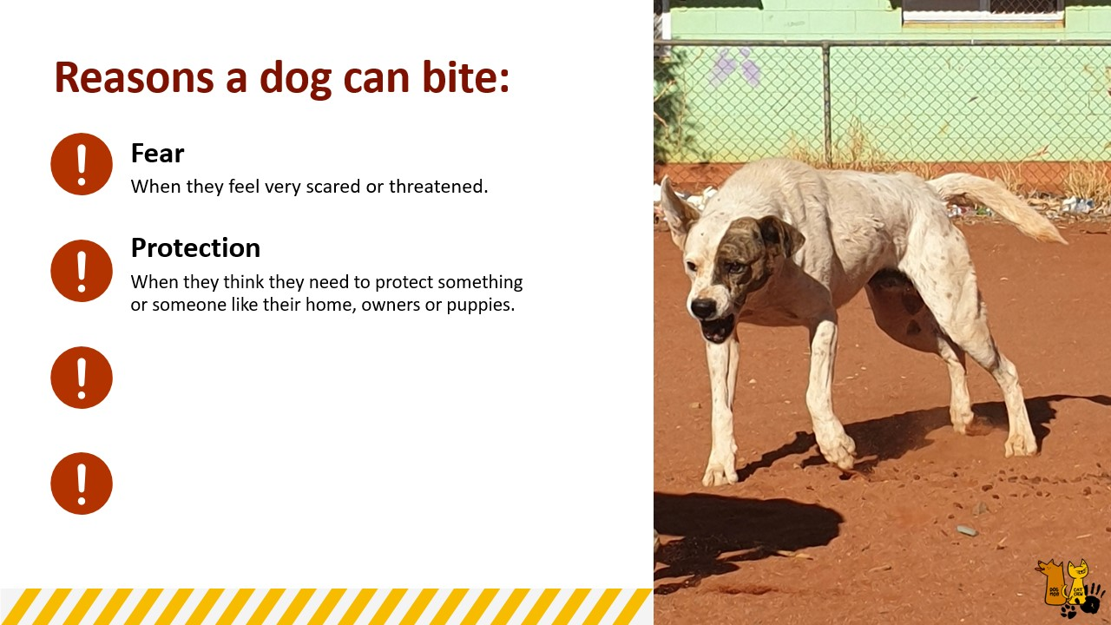
Notes:
Teacher/educator:
“Protection – When they think they need to protect something or someone, this could be protecting their home, owners, protective over food, or puppies”

Slide 46

Notes:
Teacher/educator:
“Pain – sick or injured dogs may bite when they are approached or touched”

Slide 47

Notes:
Teacher/educator:
“Playfulness – dogs can become over stimulated and bite because they are too excited”
Reference accessed April 2026: Dog Aggression: Causes, Treatment & When to Get Help | Vet Guide | Pet Behaviour Services

Slide 48
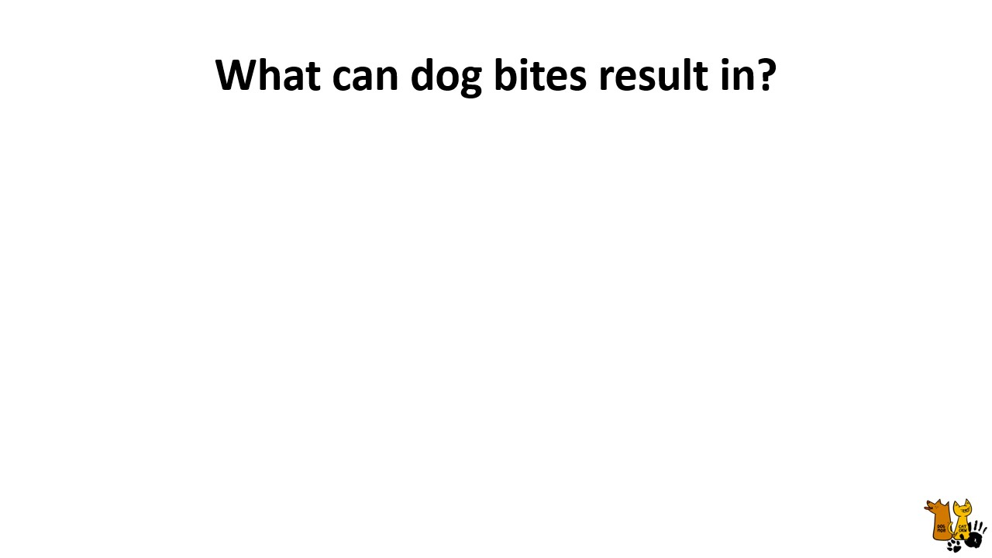
Notes:
Teacher/ Educator: [Ask class] “What can dog bites result in?” “What affect does a dog bit have on a person?”

Slide 49
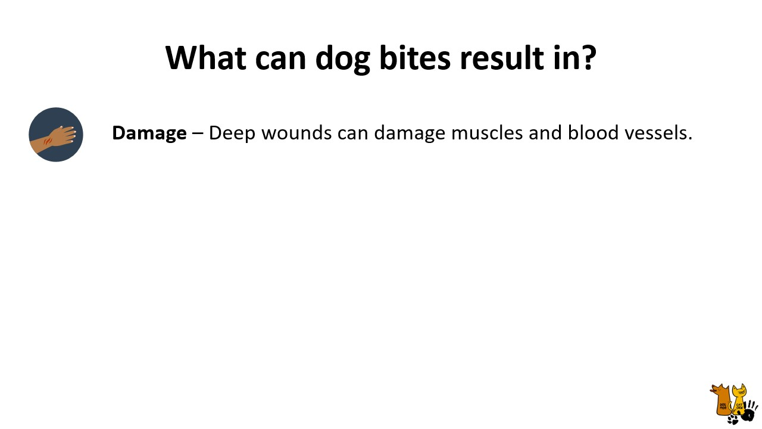
Notes:
Teacher/educator:
“Damage – potentially deep wounds that can damage muscles and blood vessels. These wounds could require surgery”

Slide 50
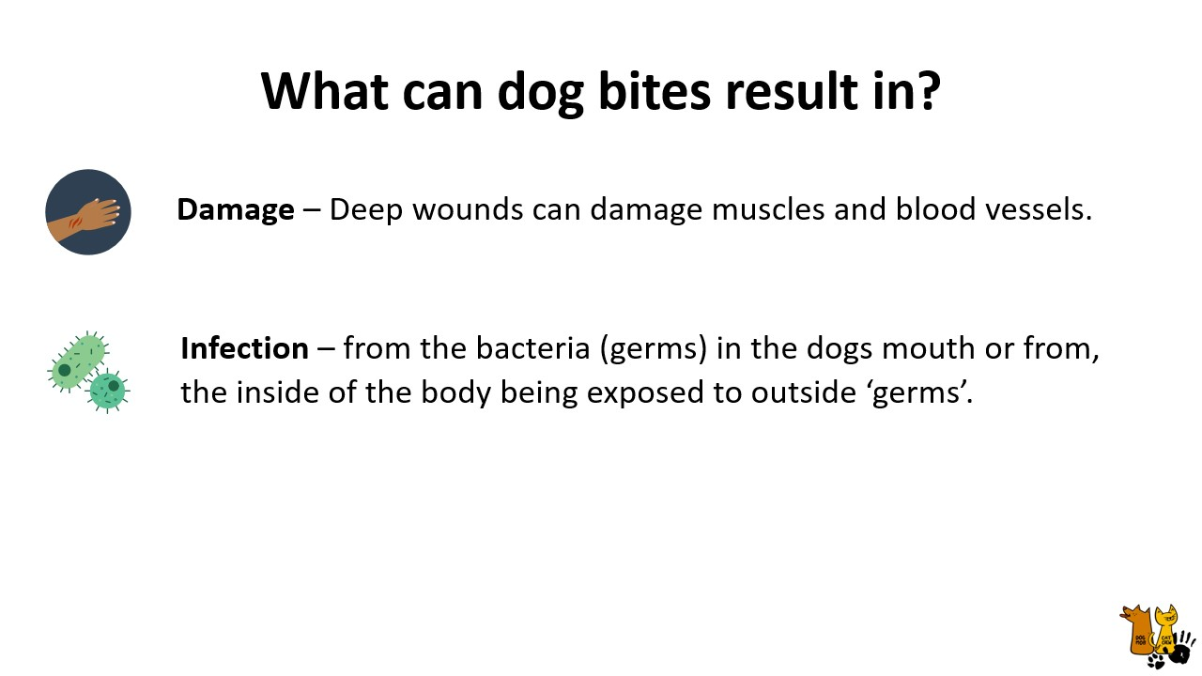
Notes:
Teacher/educator:
“Infection – dog bites can become infected, either from bacteria (germs) from the dogs' mouth, or from the wound being open to germs in the environment”

Slide 51
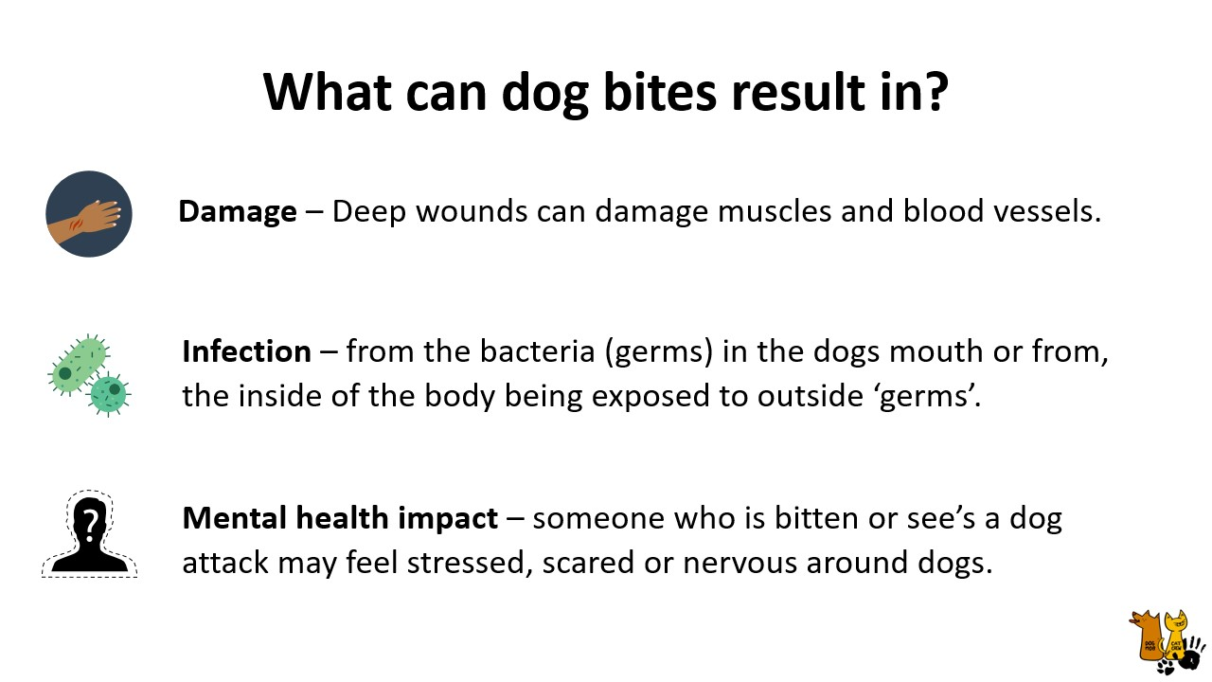
Notes:
Teacher/educator:
”Mental health impact – someone who is bitten or see’s a dog attack may feel stressed, scared or nervous around dogs”

Slide 52
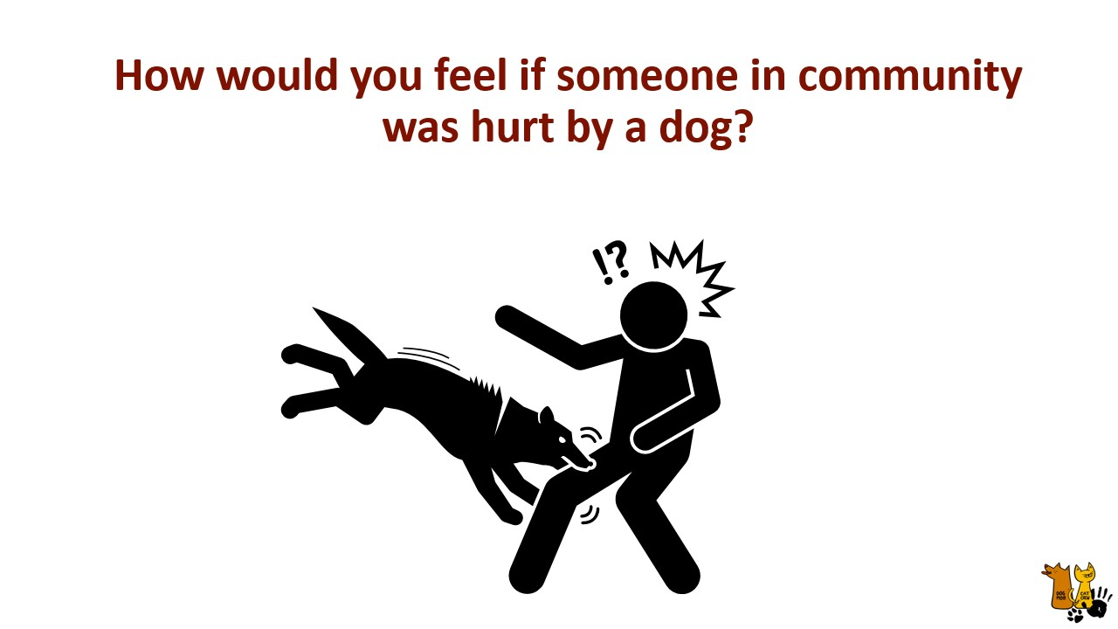
Notes:
Teacher/educator: “How the students would feel if someone in community was hurt by dog?”

Slide 53
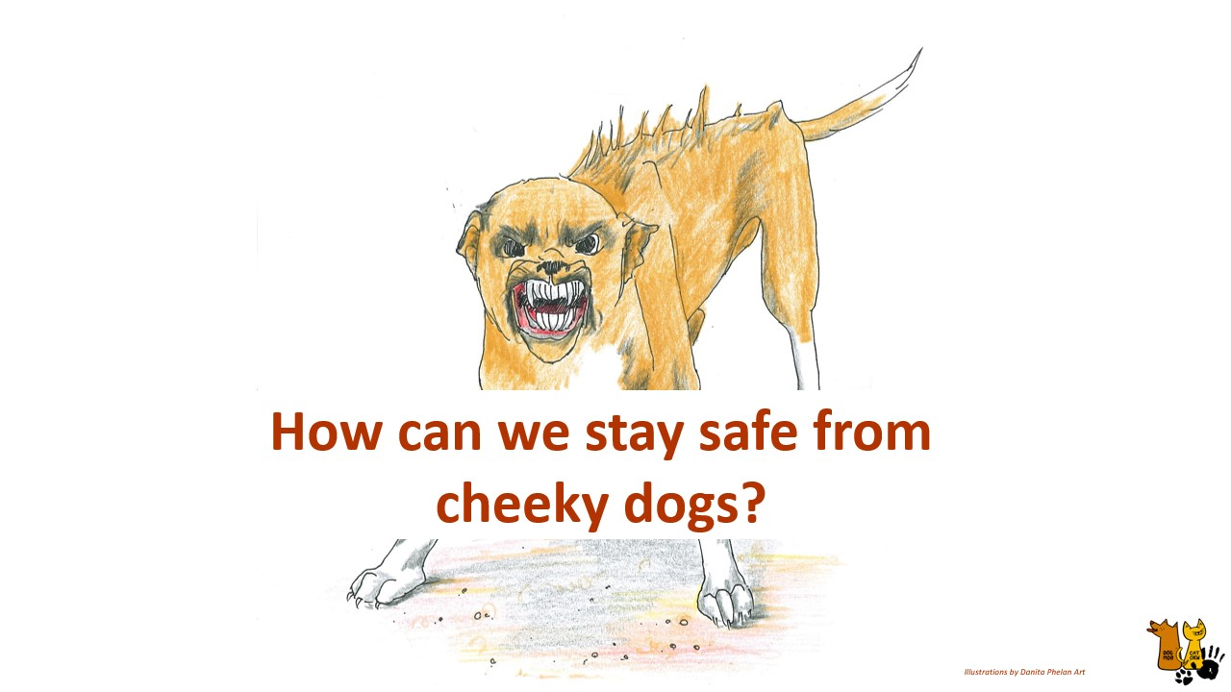
Notes:
Teacher/Educator: [Ask class] “ Does anyone have any ideas, how we can stay safe from cheeky dogs especially if they come up to us?”

Slide 54
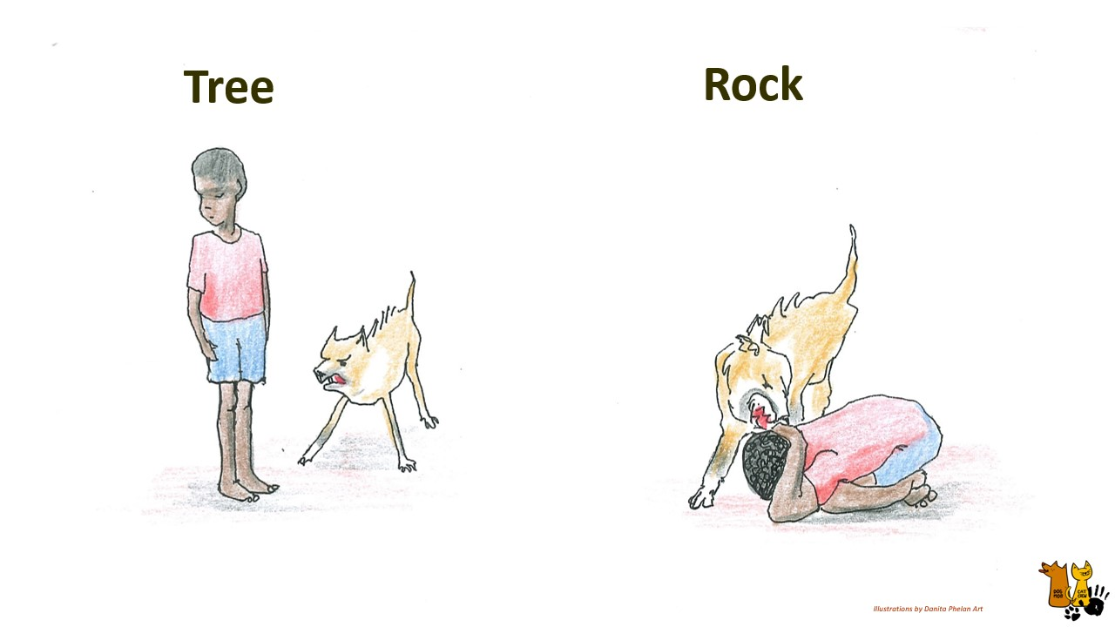
Notes:
Teacher/educator: “There are two safety positions that can be used when approached by a dog that is acting aggressively”
“The first is the Tree Position – where we stand still and do not make eye contact with the dog” “This pose shows the dog that you are not a threat.”
“The second position is the Rock position – this is only to be used if a dog jumps on you and you fall to the ground; it is the last resort because once we are on the ground we need to try and protect our head and neck.”
“For both these positions, we need to stay very still until help arrives or the dog has left you alone.”
“Only once the dog has gone away, then we can slowly move away”

Slide 55
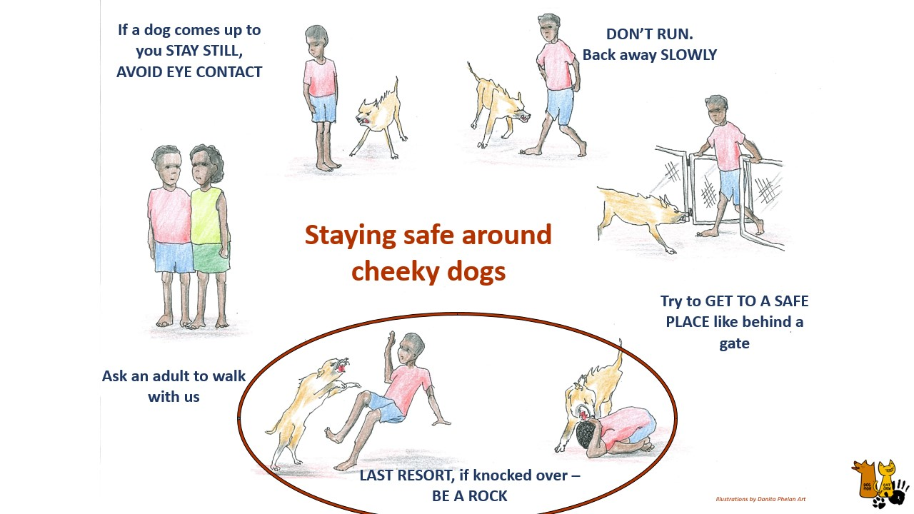
Notes:
Teacher/educator:
[Read to the class staring from ‘ask an adult to walk with us’ bottom left corner, working your way clockwise around and ending on ‘LAST RESORT’]
“Here’s a diagram of the steps we can take to try and stay safe around dogs that me be cheeky,
CLICK….“Ask someone to walk with us”
CLICK….”If a dog comes up to you, Stay still, avoid eye contact”
CLICK…”Don’t run, back away slowly”
CLICK…” Try to get to a safe place”
CLICK…. Last resort, if knocked over – get into the Rock position”

Slide 56
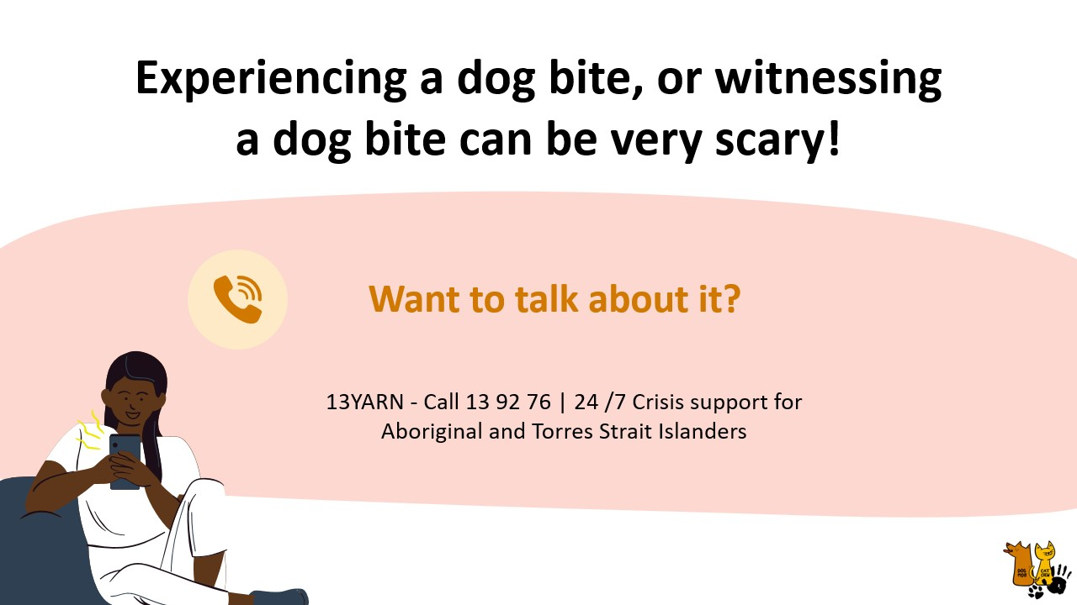
Notes:
Teacher/educator: “Dog bites can be very scary for everyone involved, and if it’s something you would like to talk about you can call 13Yarn which is a call line to provide support, or your school and health clinic may know others to call as well.”

Slide 57
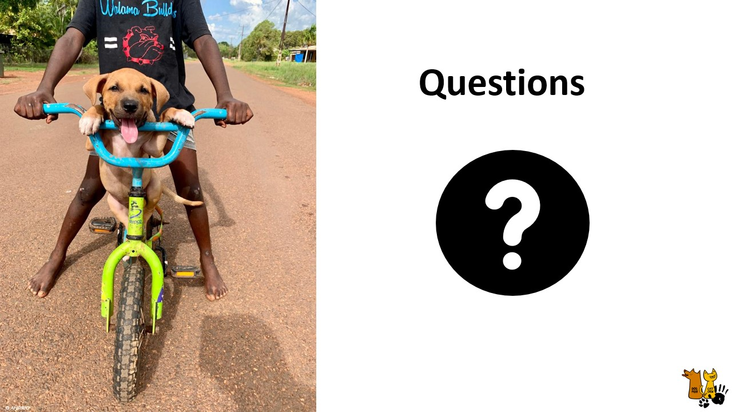
Notes:
Teacher/educator: “Does anyone have questions?”

Slide 58

Notes:
Teacher/Educator: [Thank the students and teachers for participating.]
[If distributing any posters/brochures or activity sheets – suggest handing these out now]

Slide 59

Notes:
Teacher/Educator Lesson Overview

